Slide 1
Fuzzy Logic, Classical Sets, Fuzzy sets,
Compositions
Membership Functions
Week 4 - 5 - 6-7
Lecture 4 - 5 - 6- 7

Slide 2
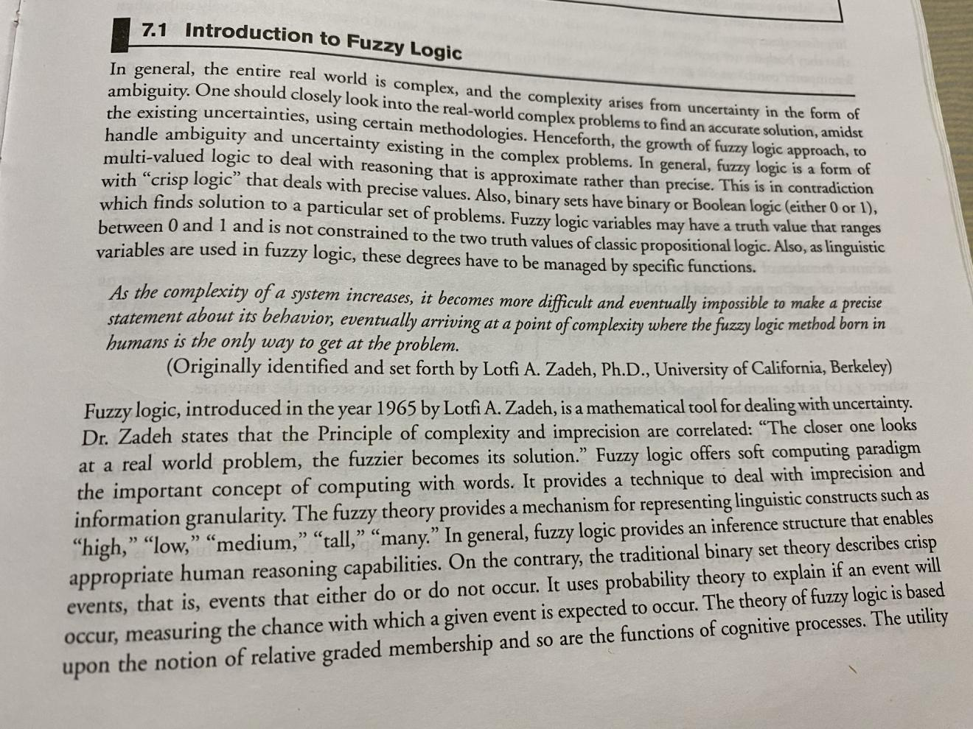

Slide 3
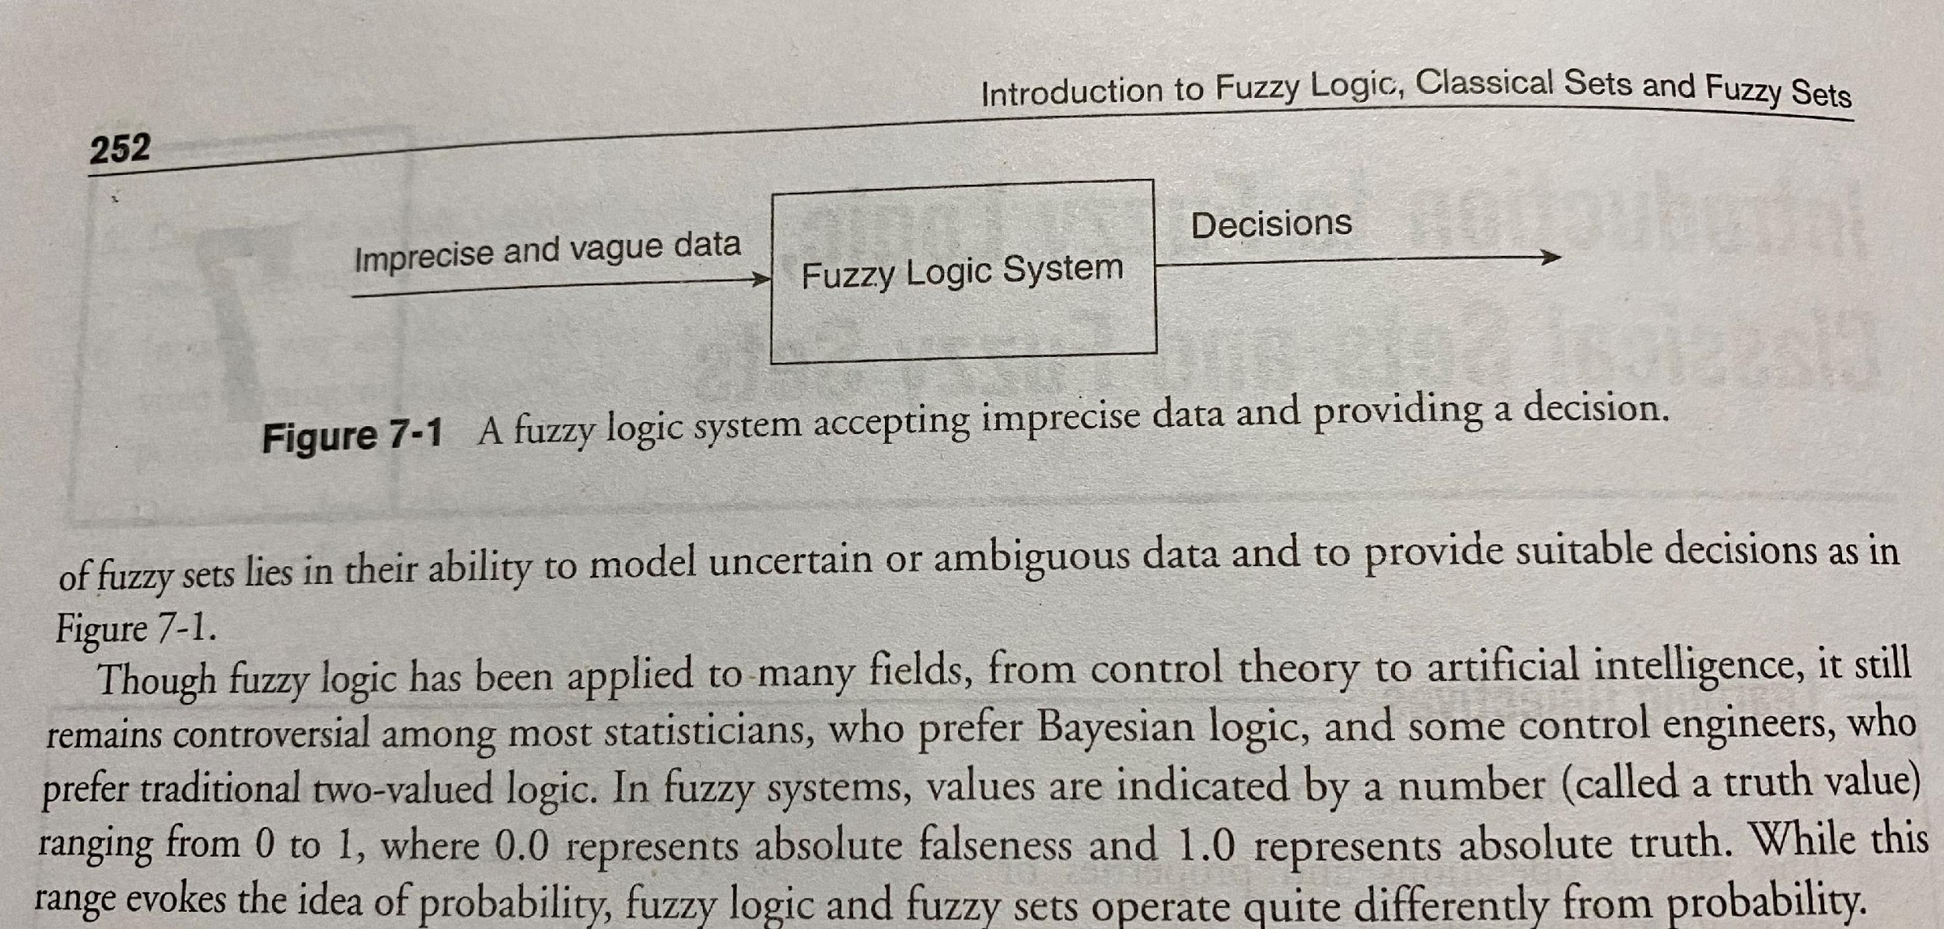

Slide 4
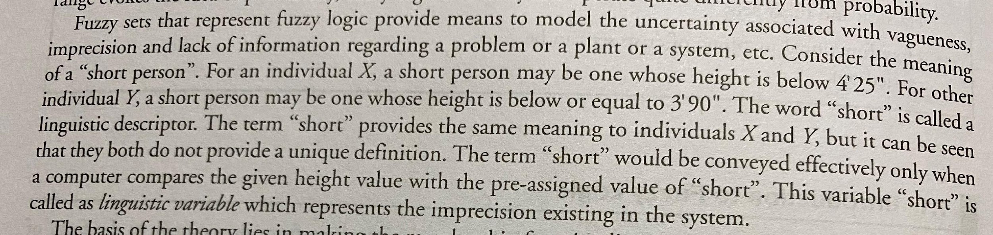

Slide 5
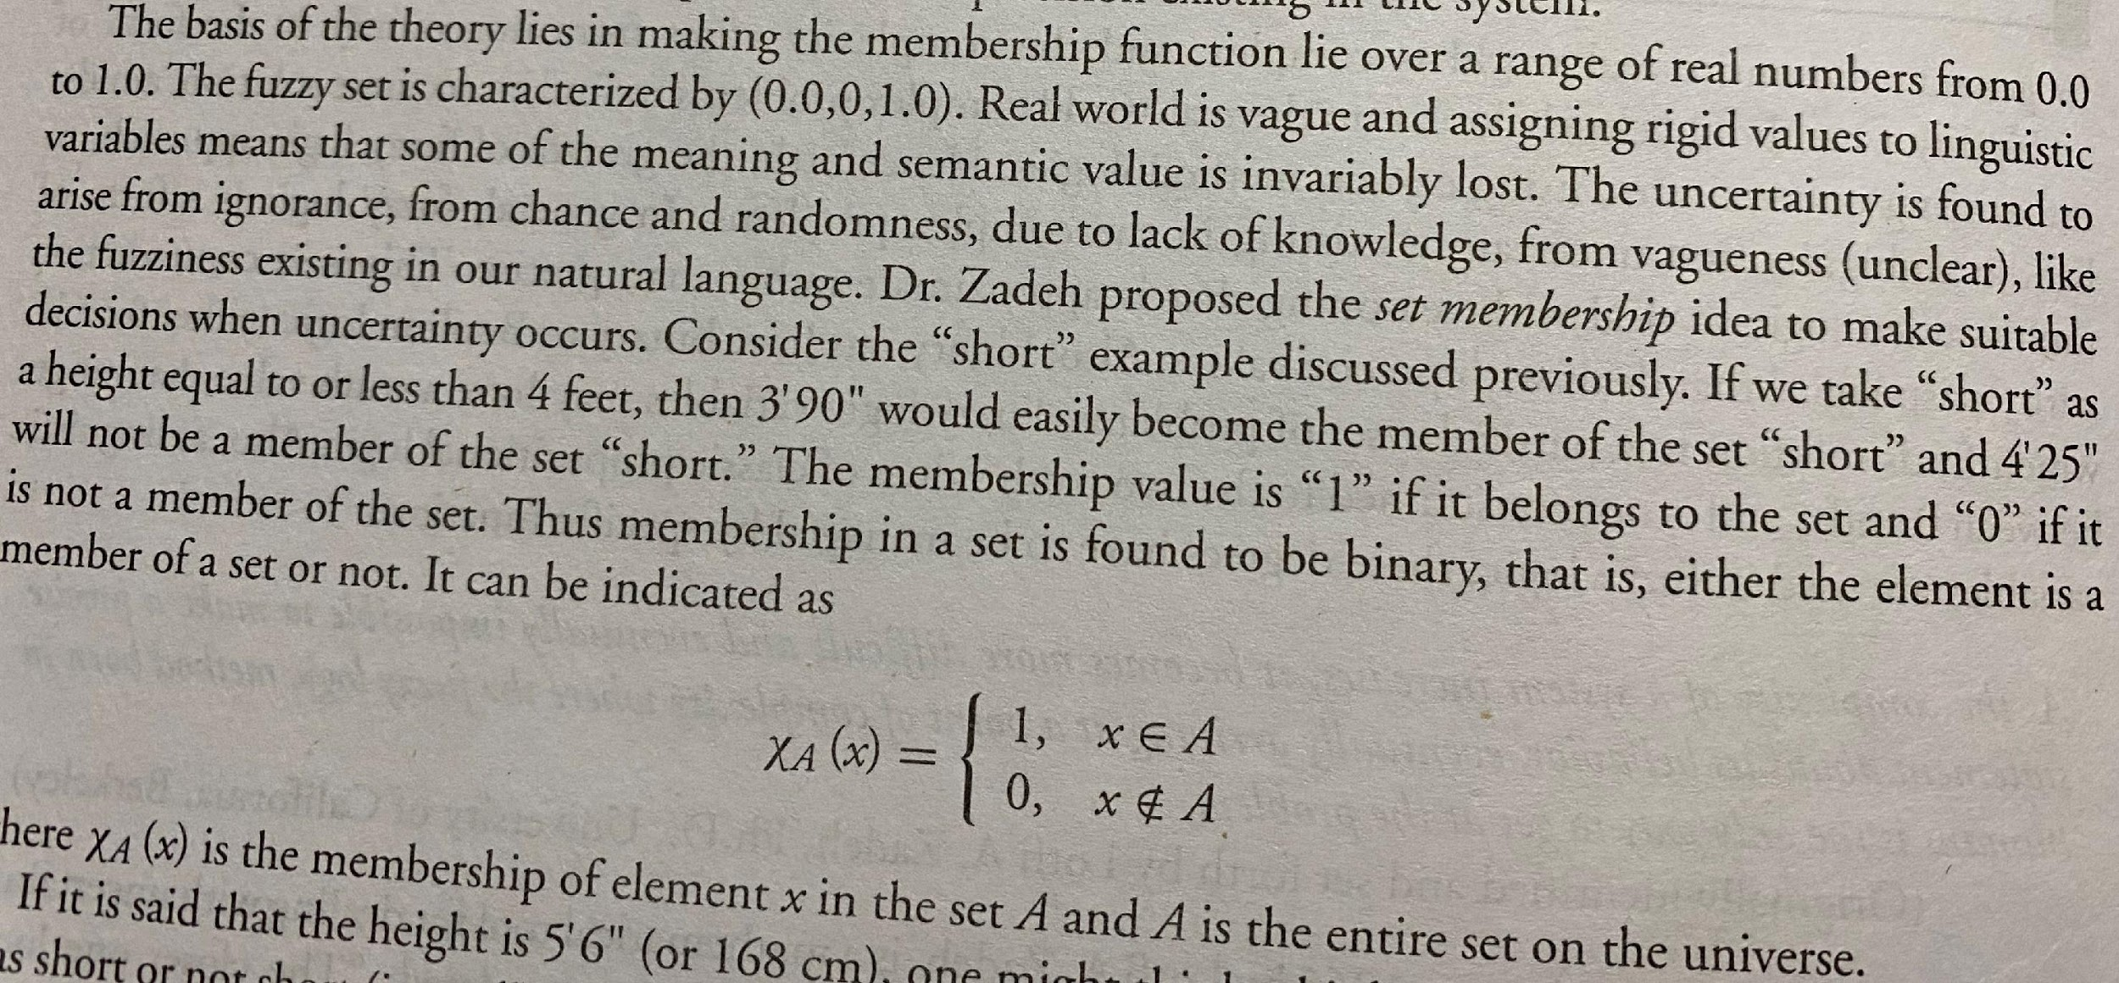

Slide 6
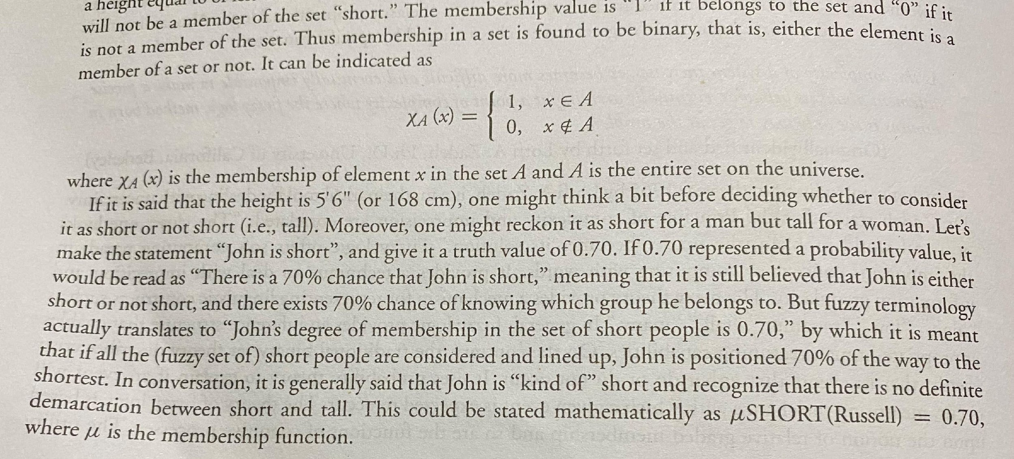

Slide 7
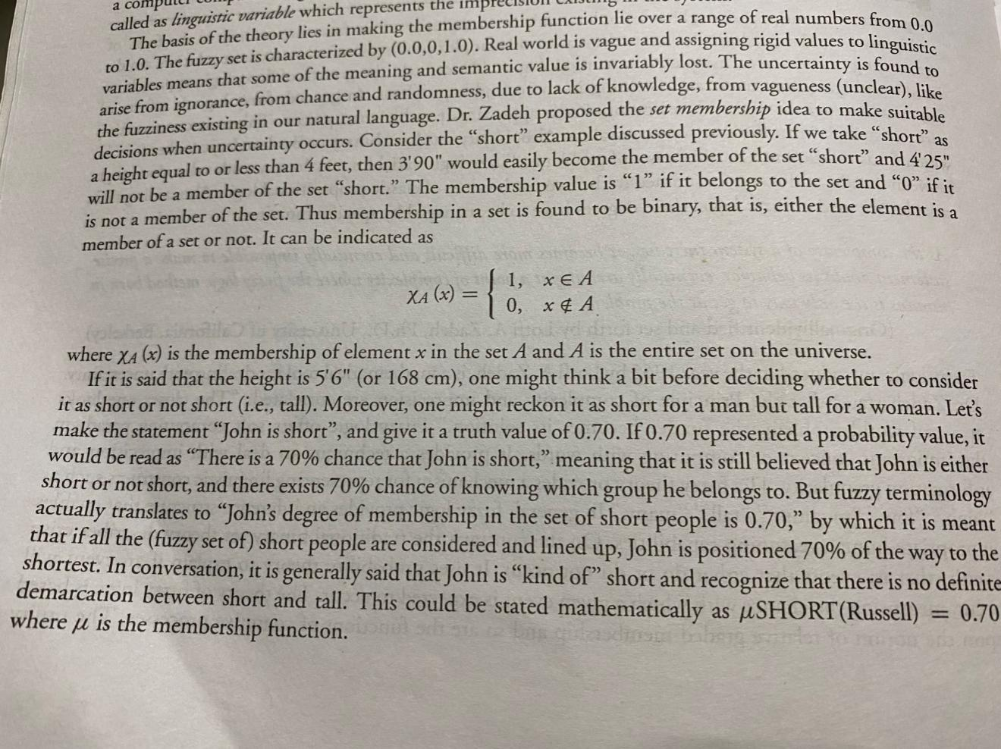

Slide 8
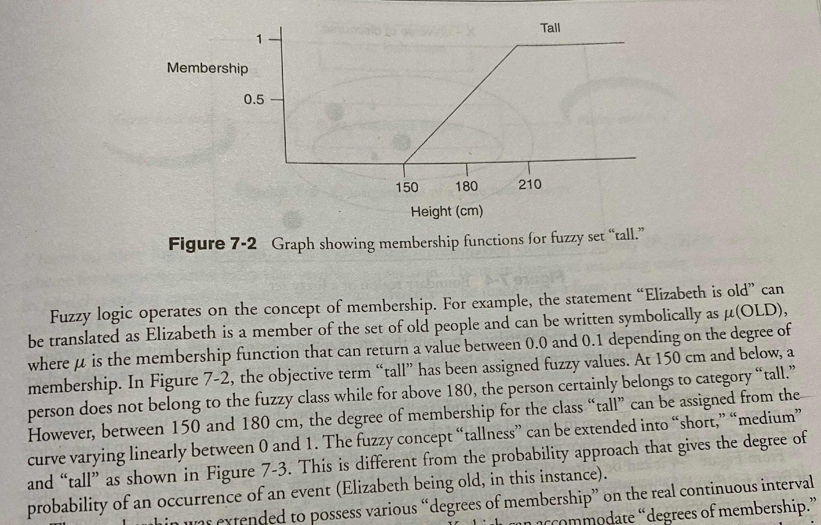

Slide 9
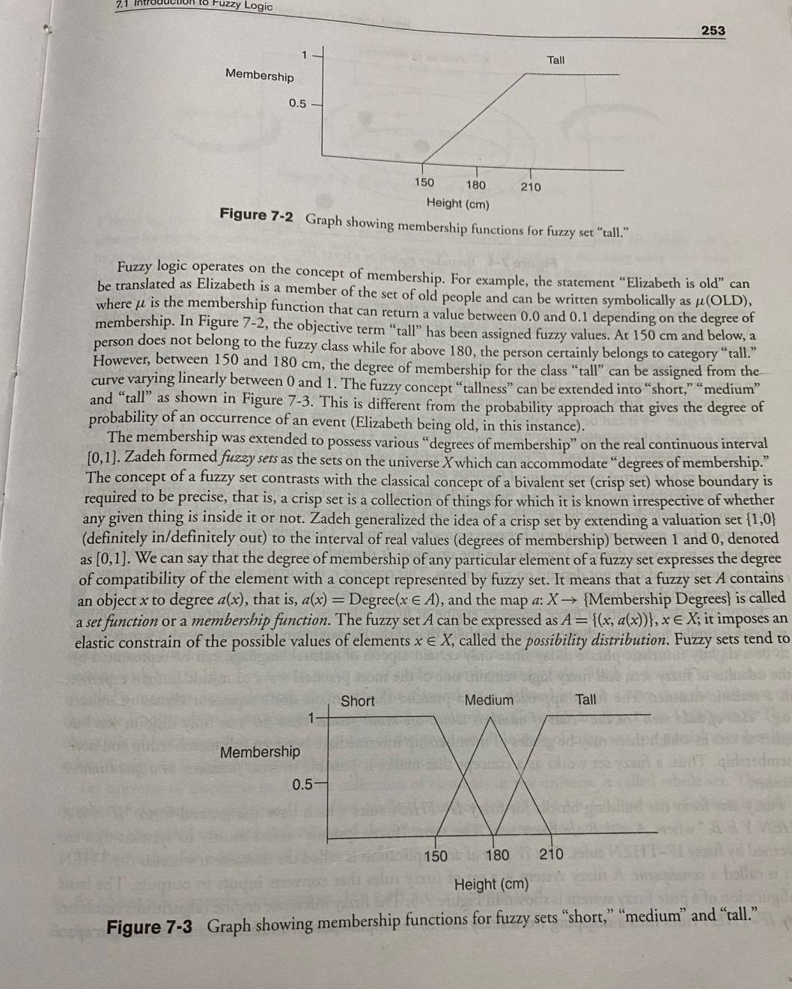

Slide 10
Fuzzy Logic
In genearal, the entire world is complex and the complexity arises from uncertainty in the form of ambiguity.
Fuzzy logic is a mathematical tool for dealing with uncertainty.
Fuzzy logic provides inference structure that enables appropriate reasoning capabilities.
Theory of fuzzy logic, based upon the relative graded membership.
Dr. Zadeh proposed the set membership idea to make suitable decisions when uncertainty occurs.

Slide 12
Classical Sets

Slide 13
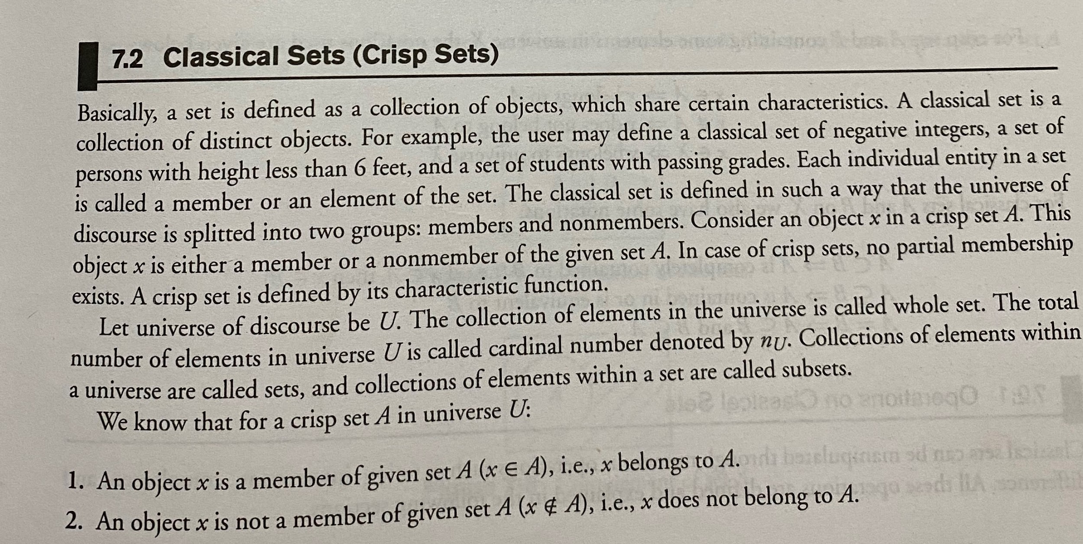

Slide 14
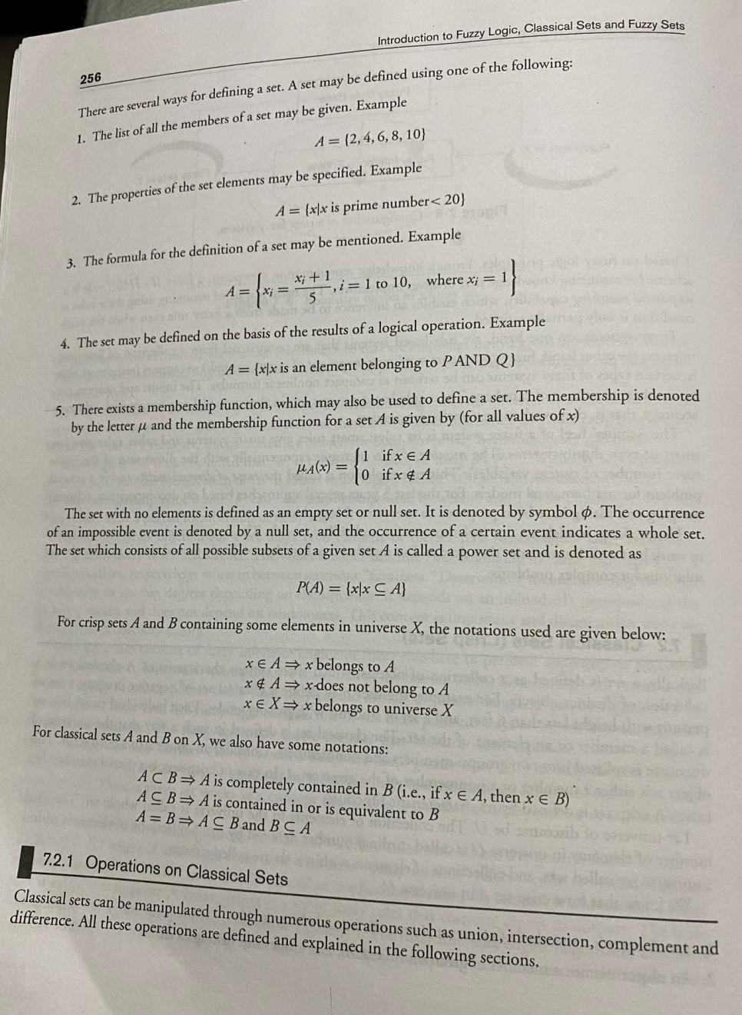

Slide 15
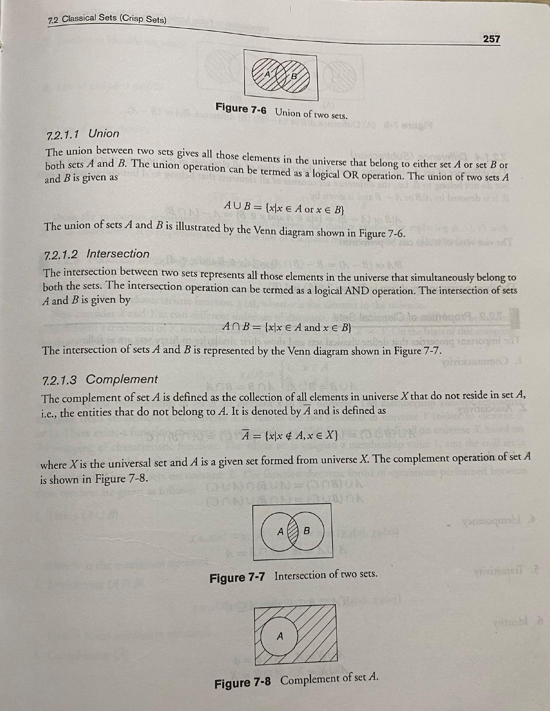

Slide 16
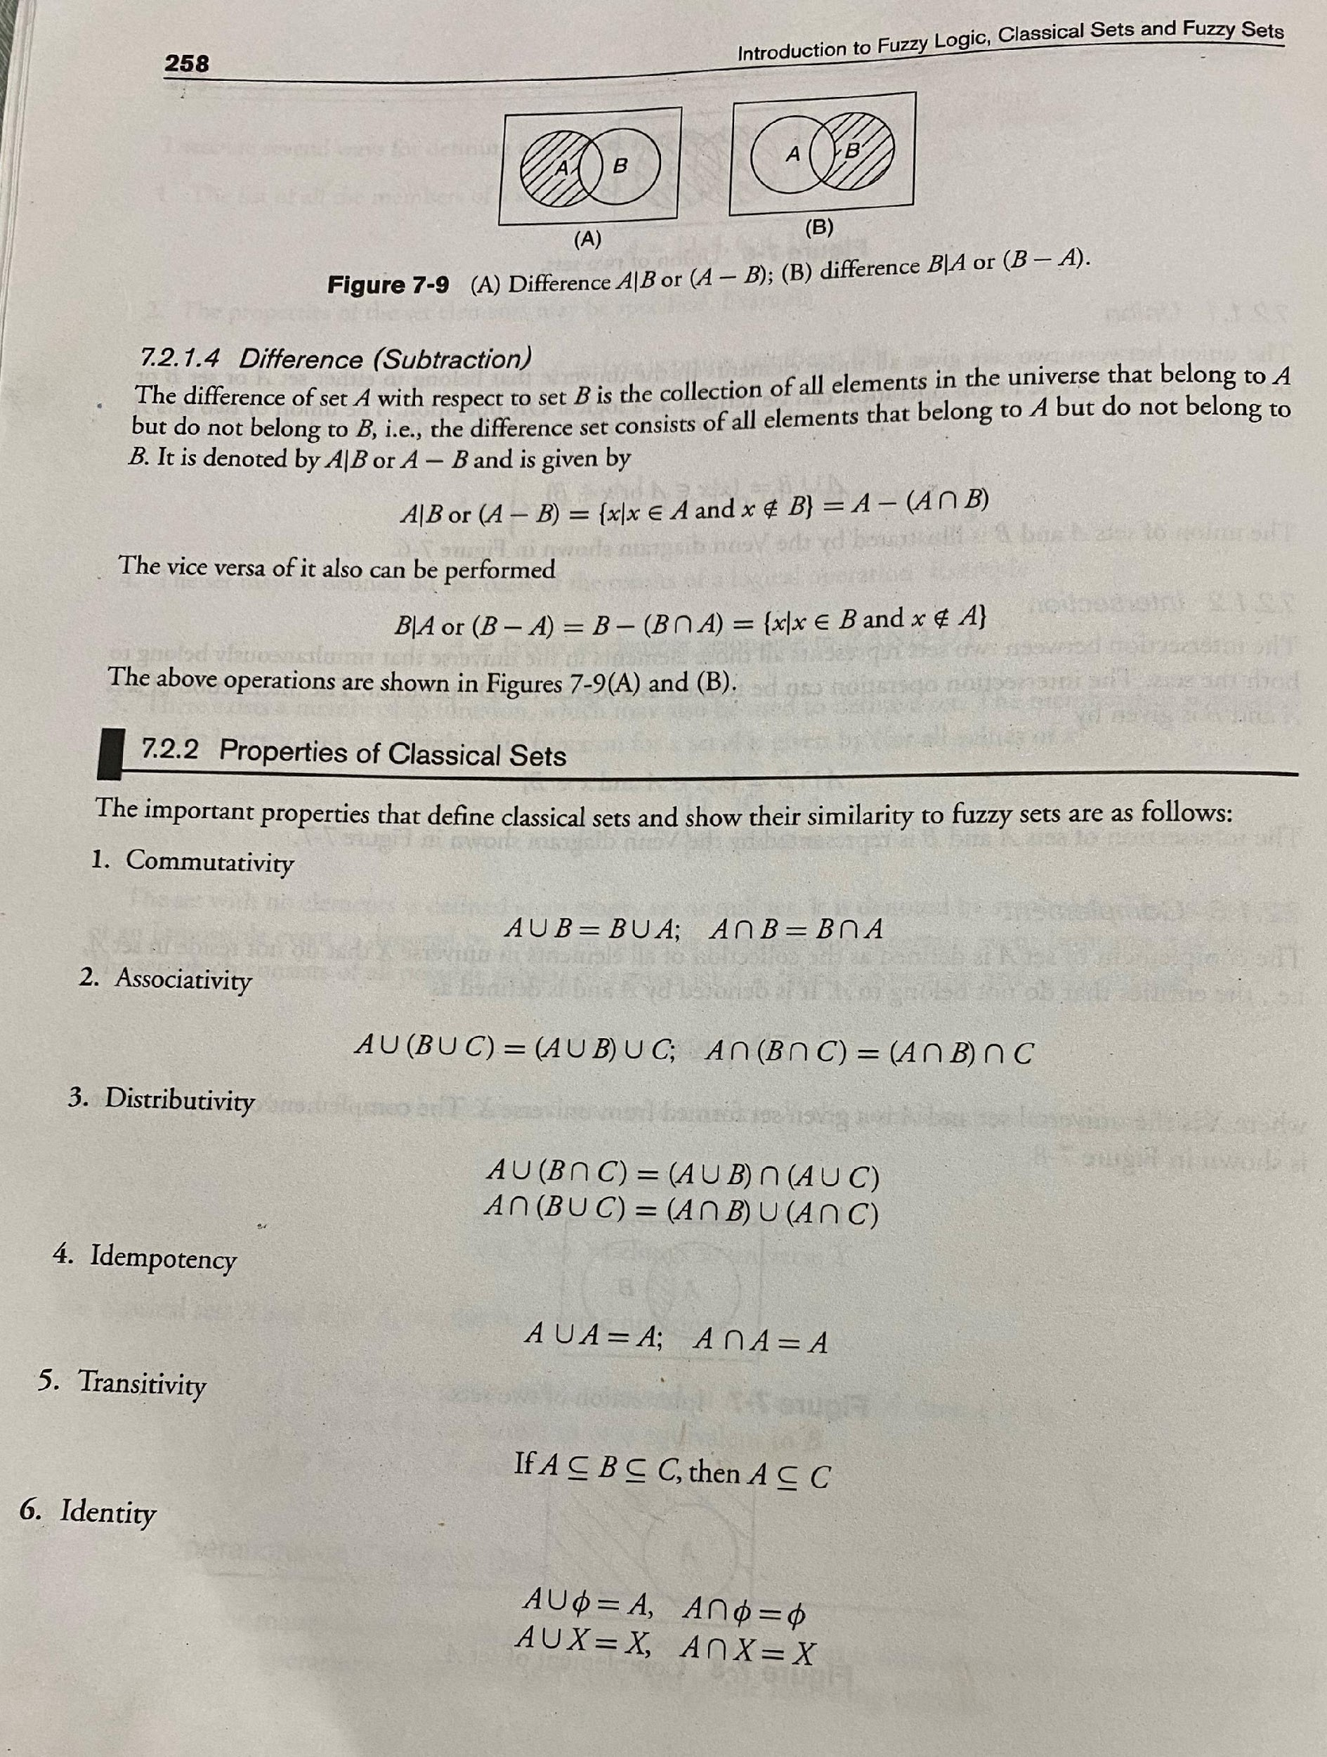

Slide 17
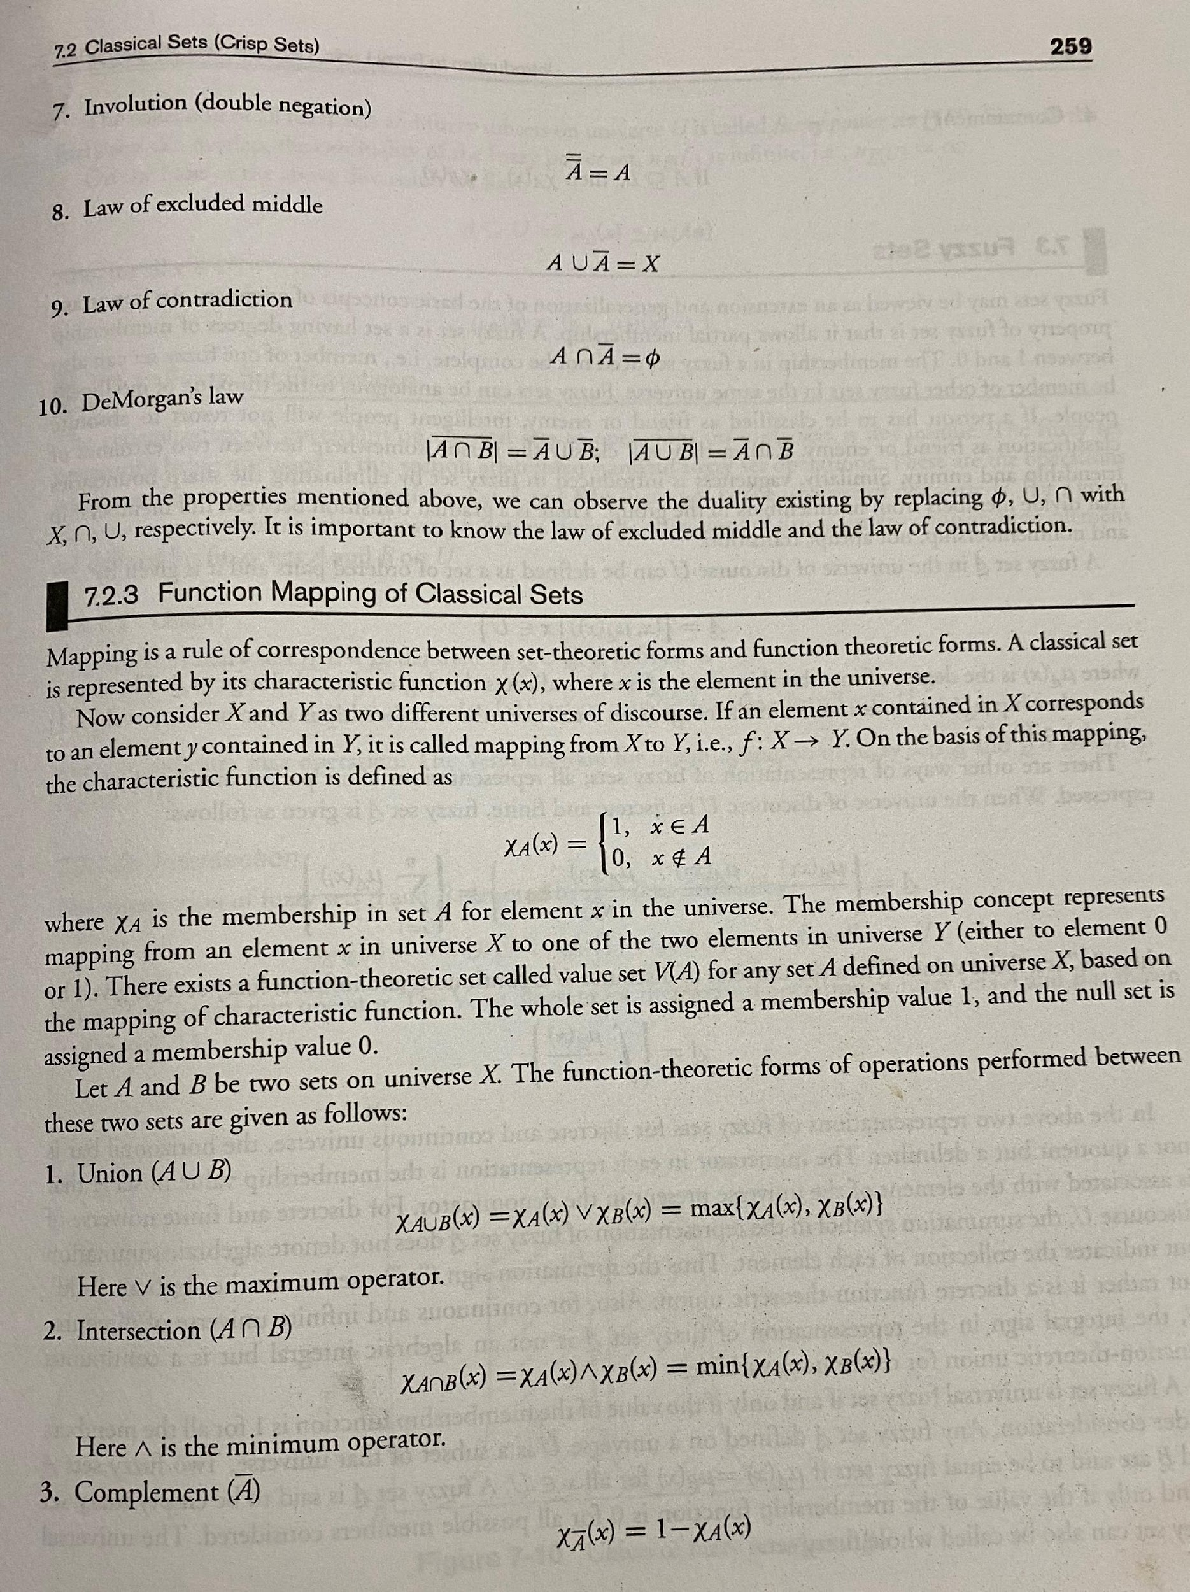

Slide 18
Fuzzy Sets
Generalization of the basic concepts of crisp sets.

Slide 19
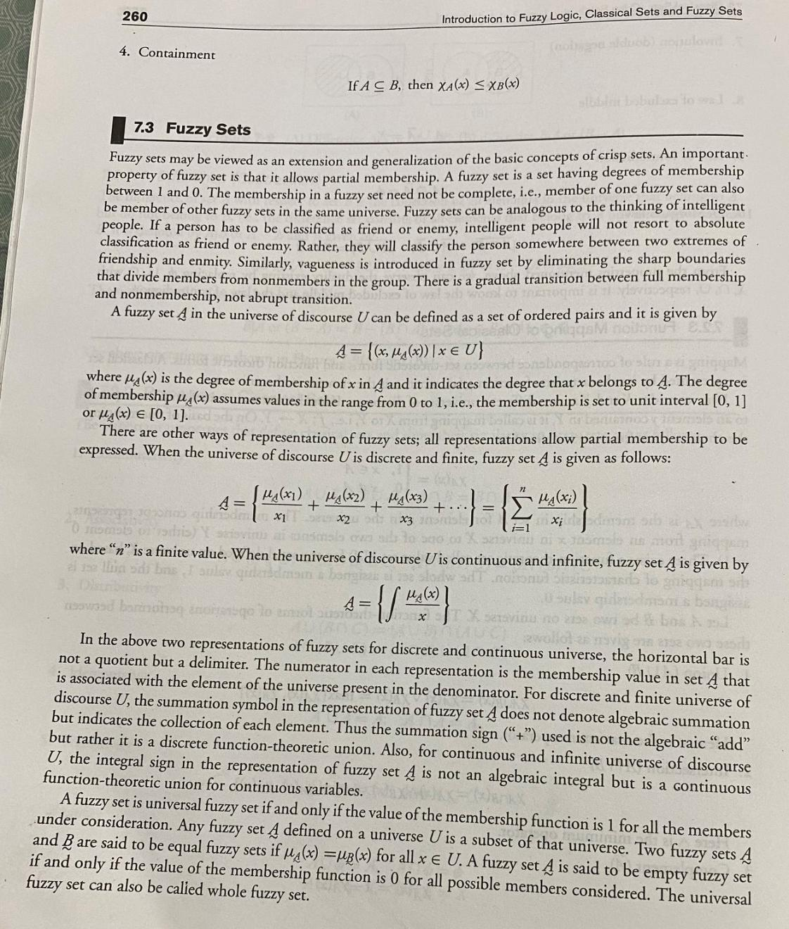

Slide 20
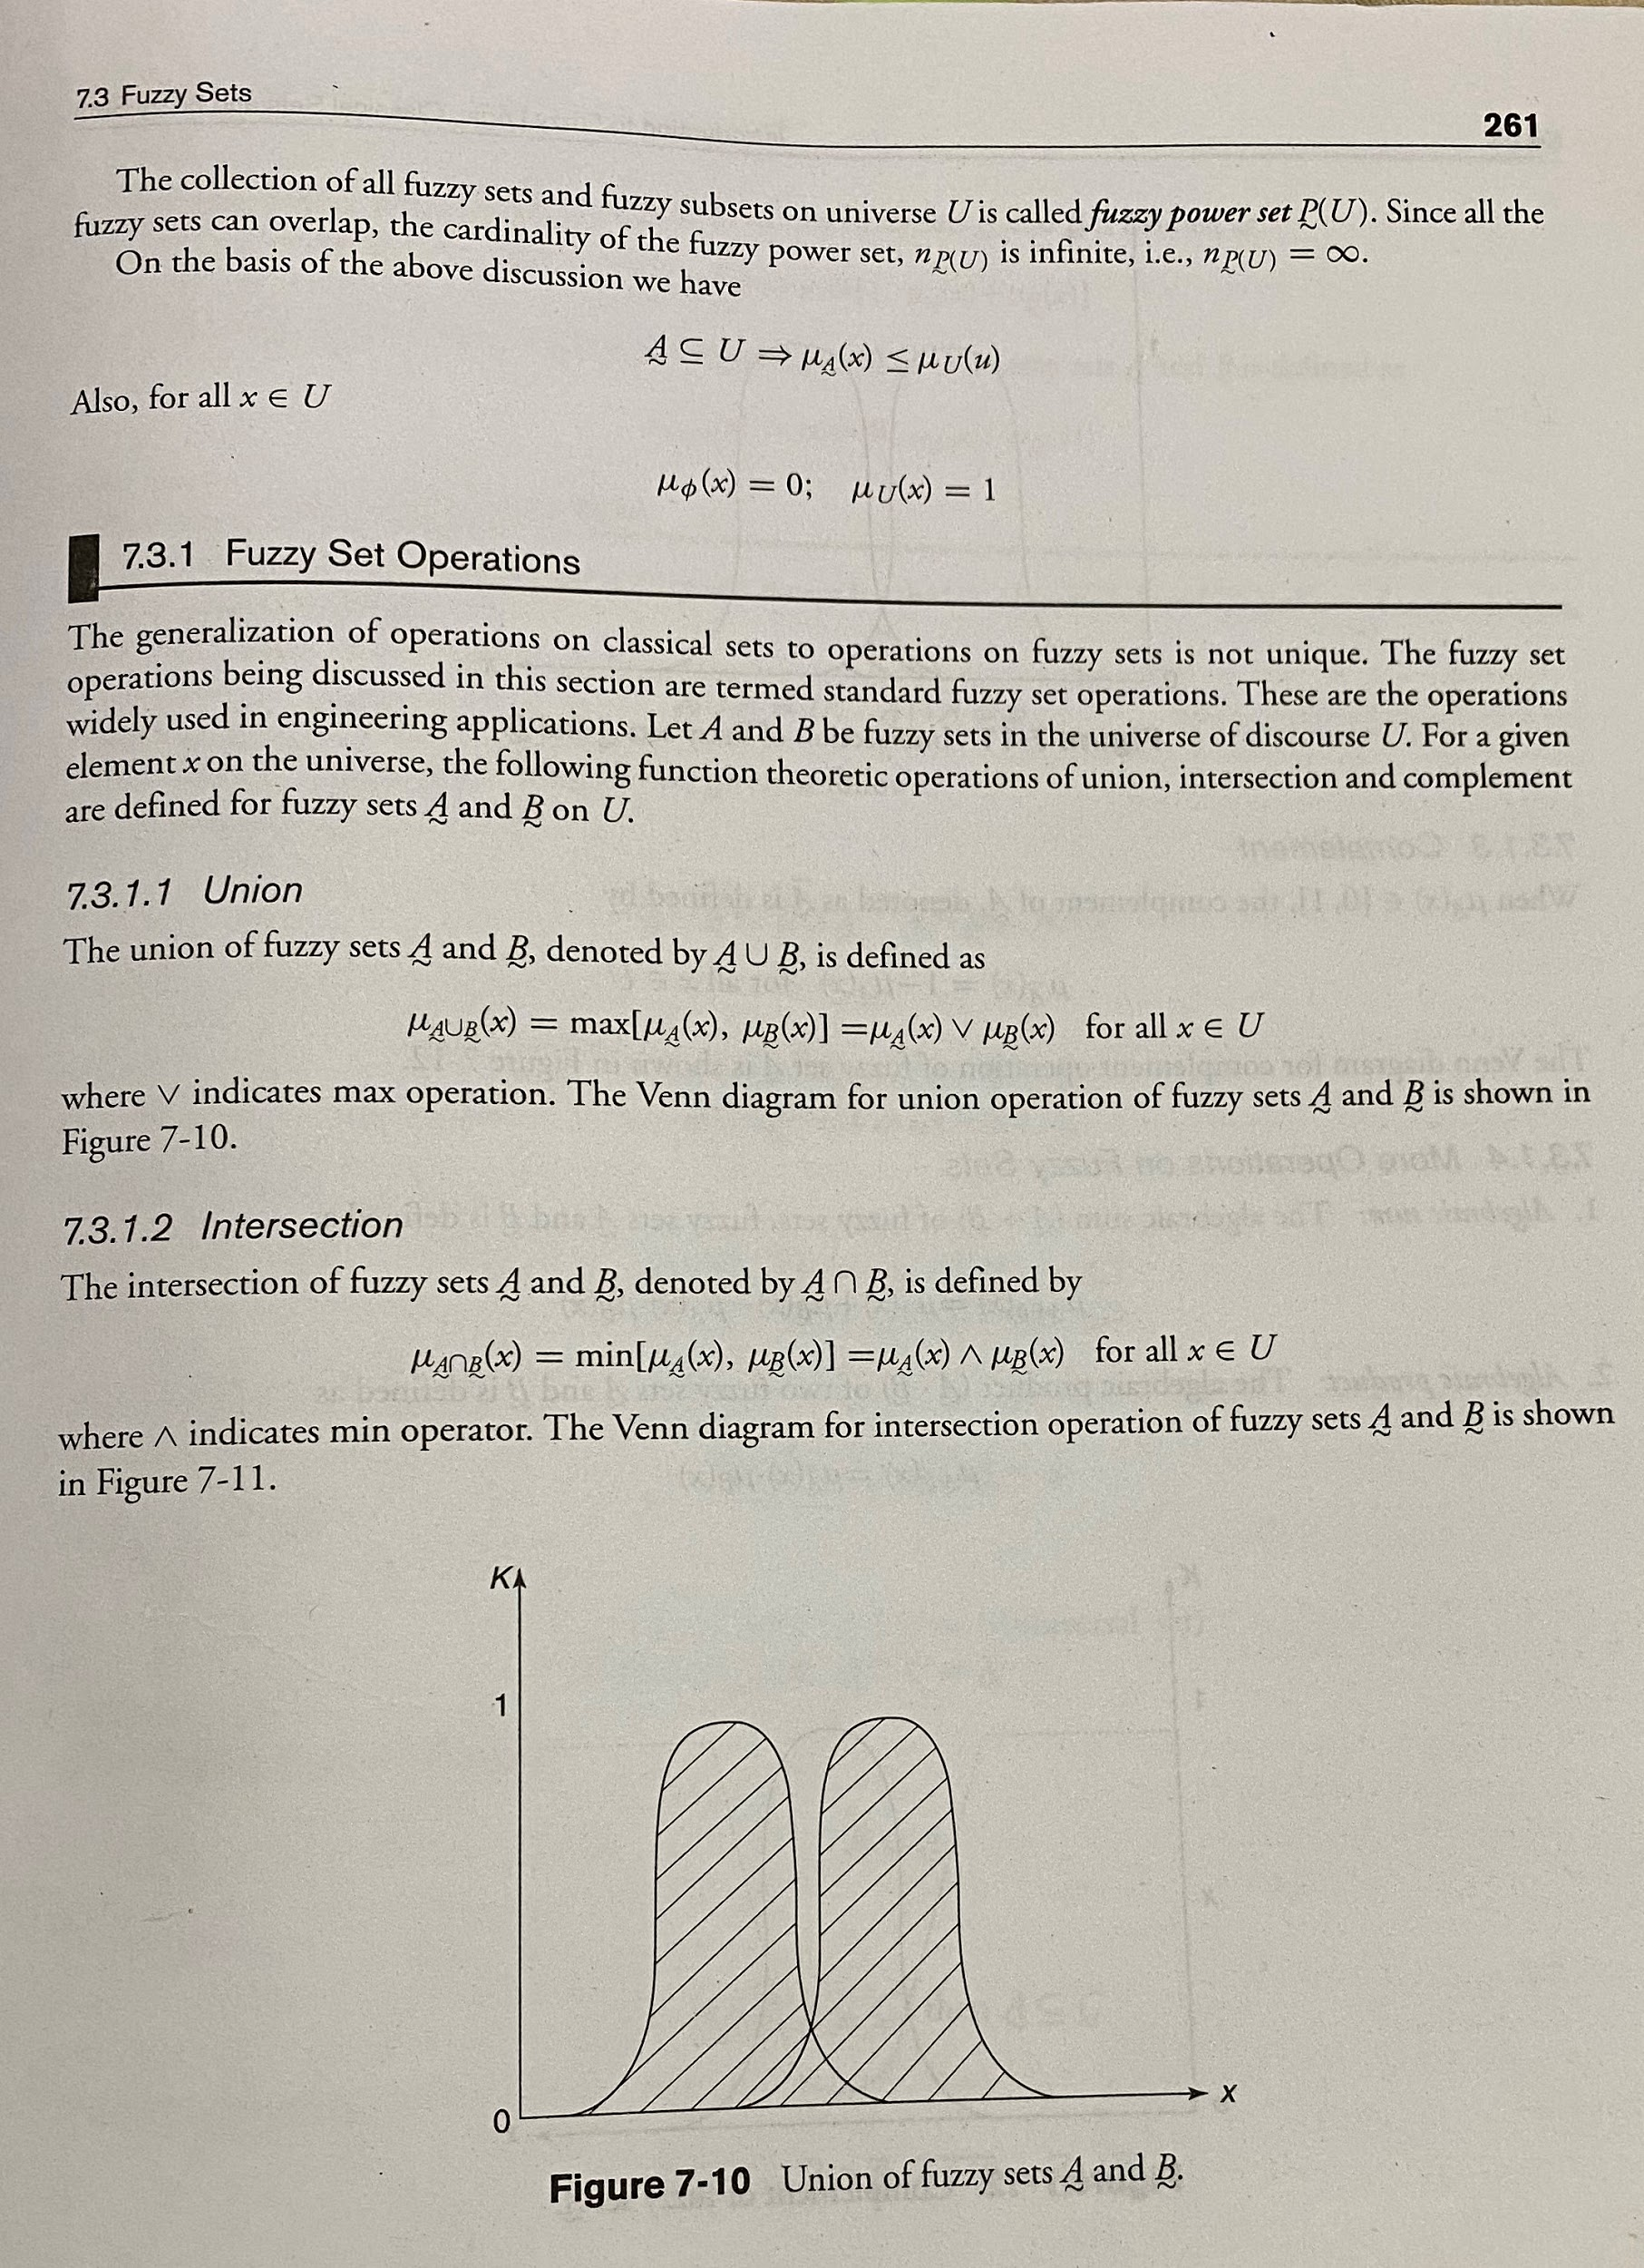

Slide 21
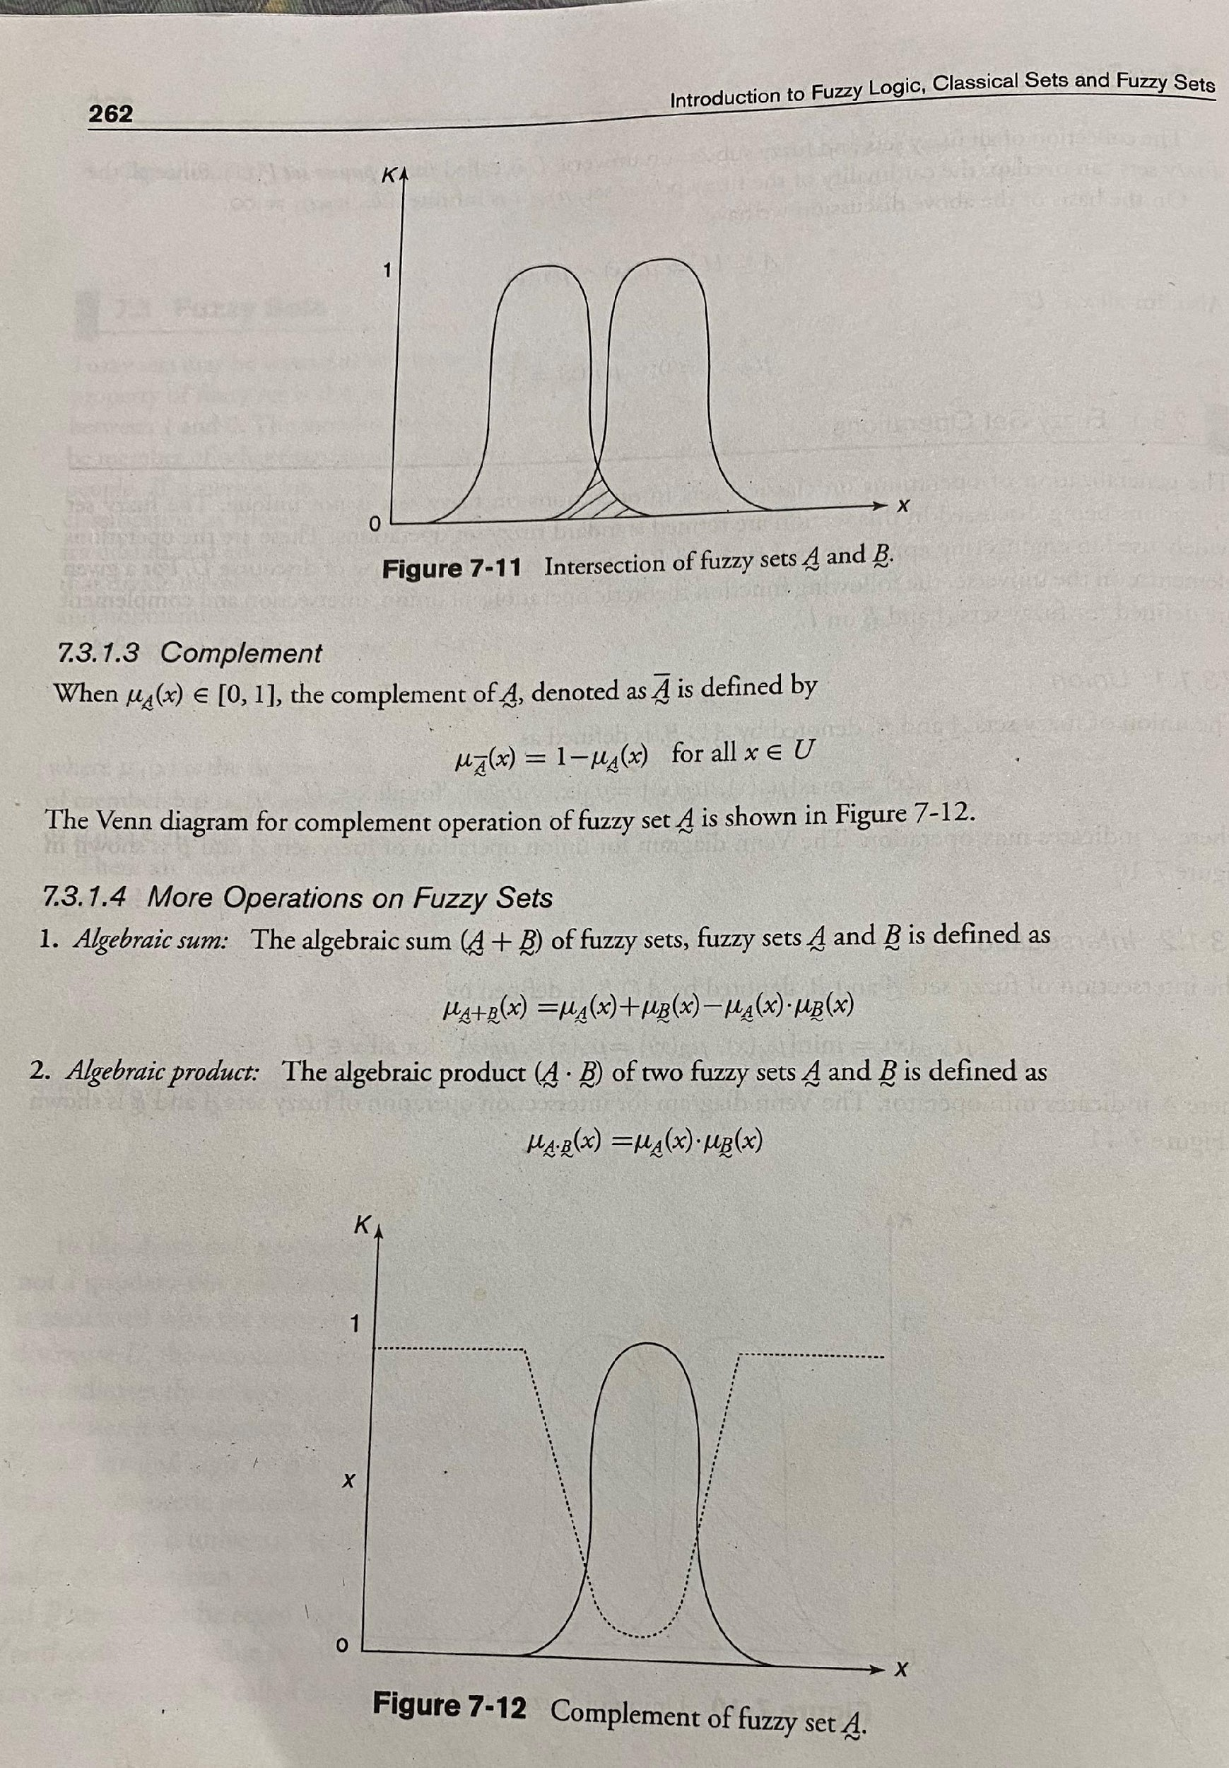

Slide 22
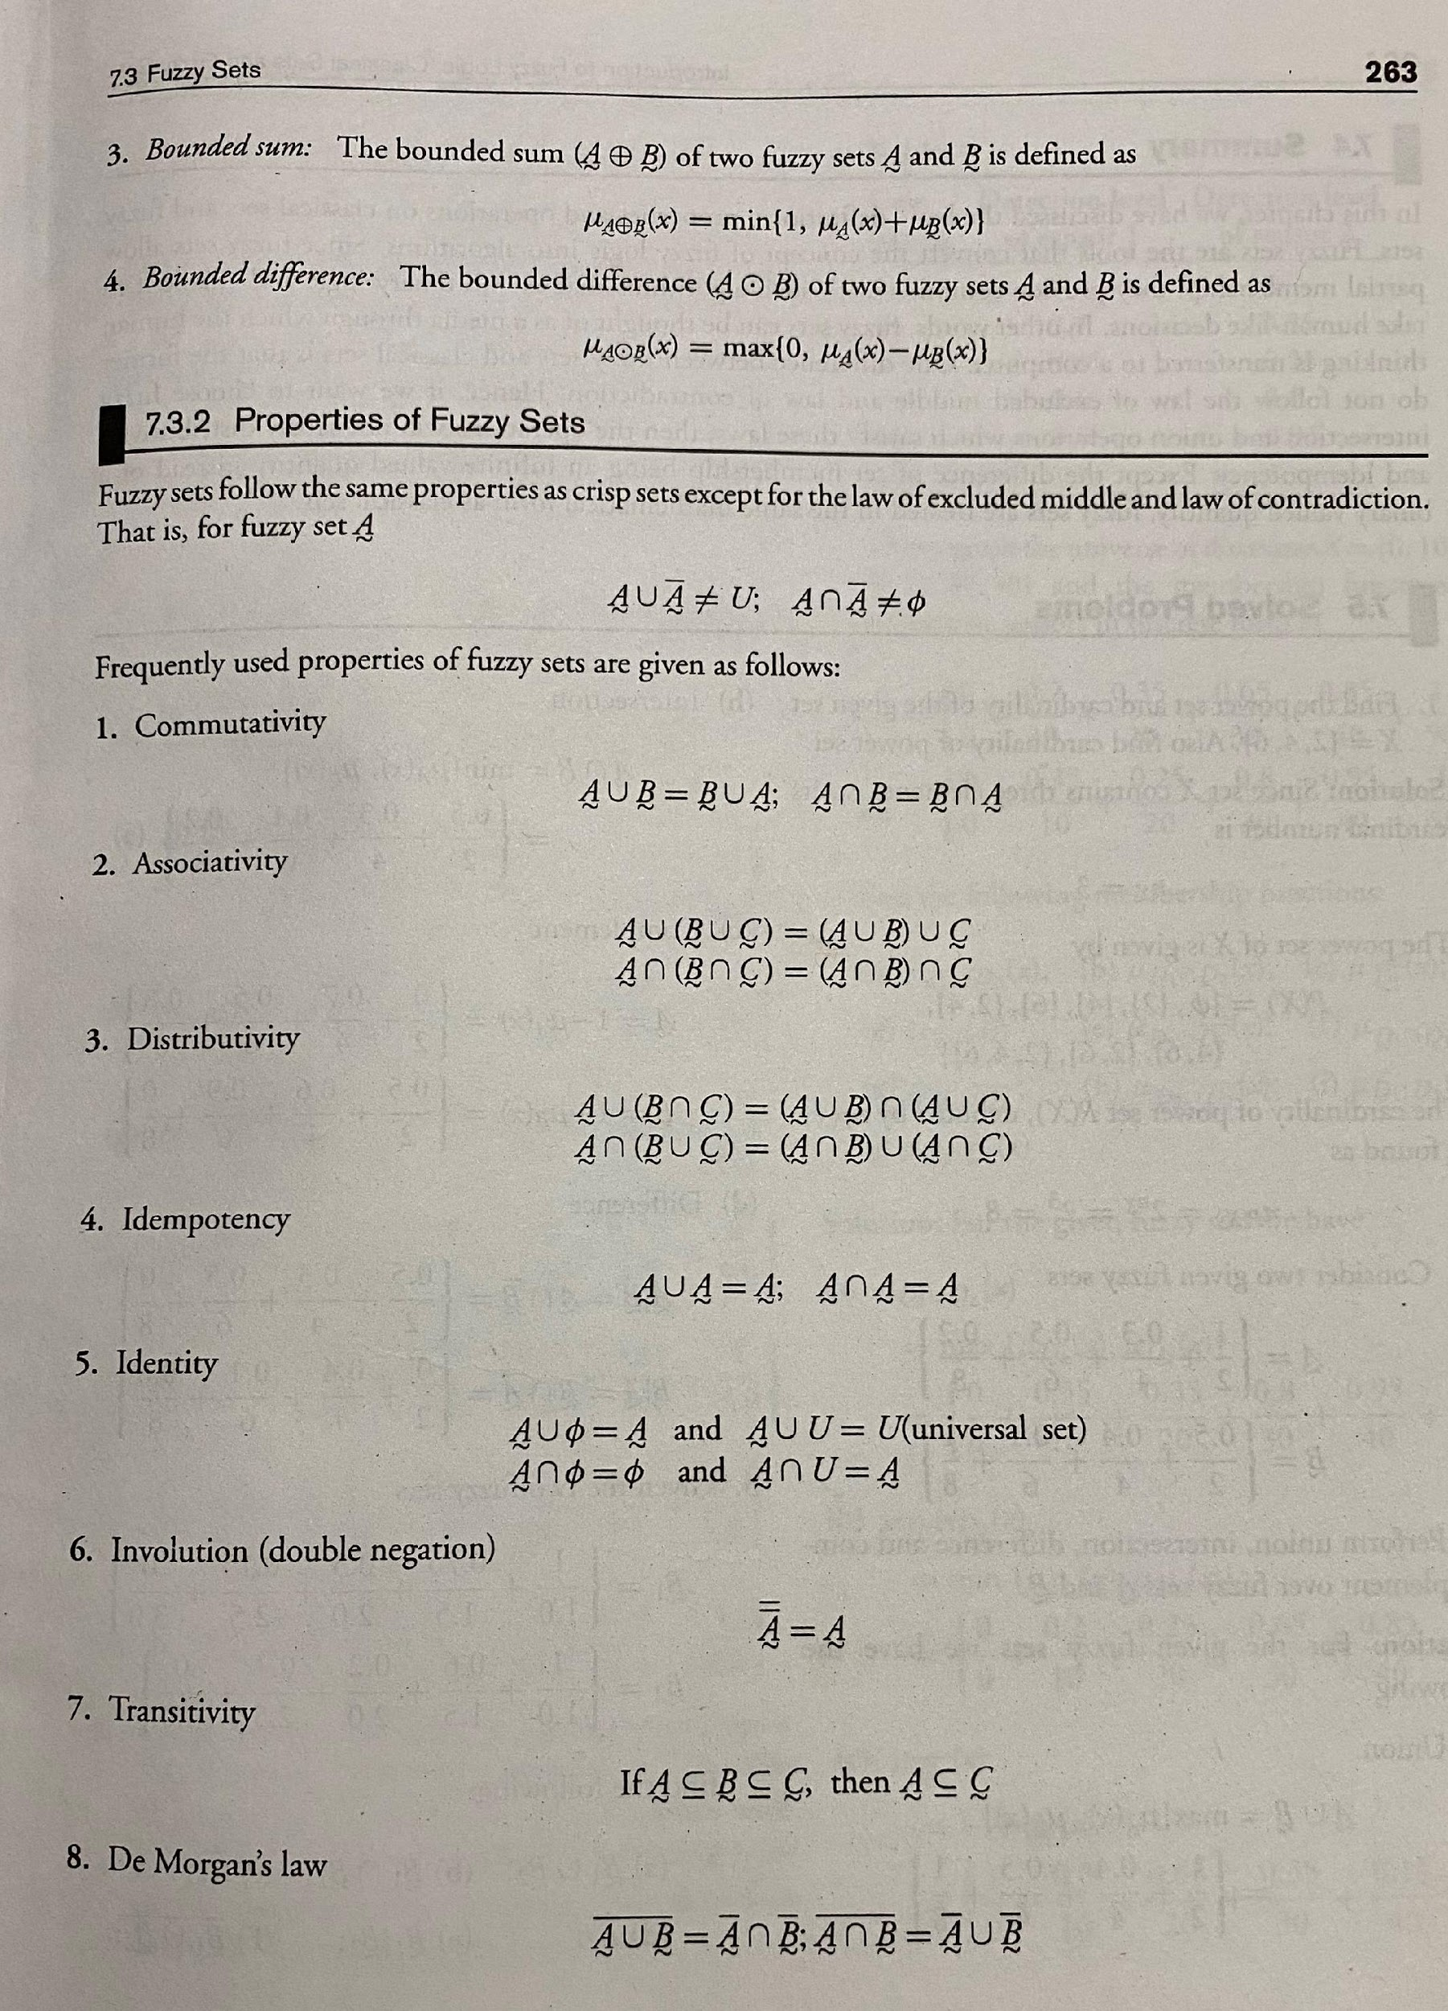

Slide 23
Null Set, Universal Set,Power set Fuzziness vs Prabability Features of fuzzy set Ex on Features of Fuzzy set Ex on Fuzzy sets Classical Relation
Lecture 5
03 Feb 2021

Slide 24
Recap
Introduction to Fuzzy logic
Crisp/Classical set
Operations on classical sets
Introduction to Fuzzy set
Operations on Fuzzy set (Union, Intersection and Complement)

Slide 25
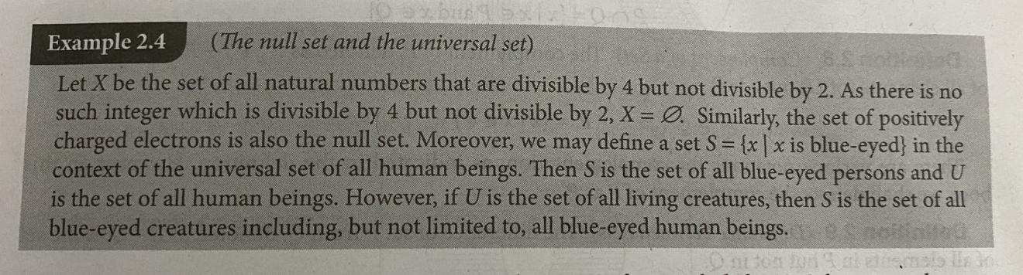

Slide 26
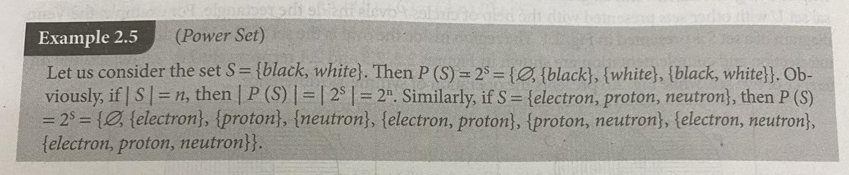
Power Set

Slide 27
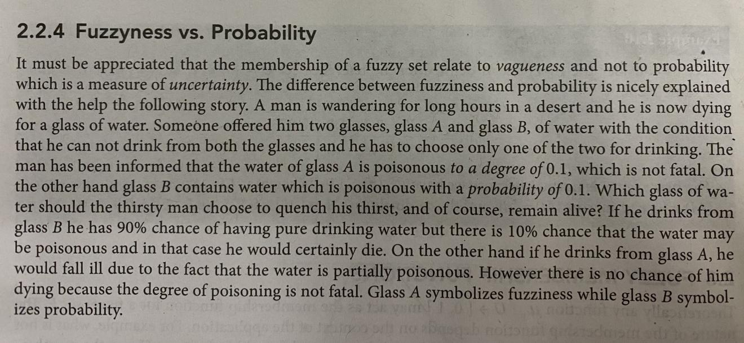

Slide 28
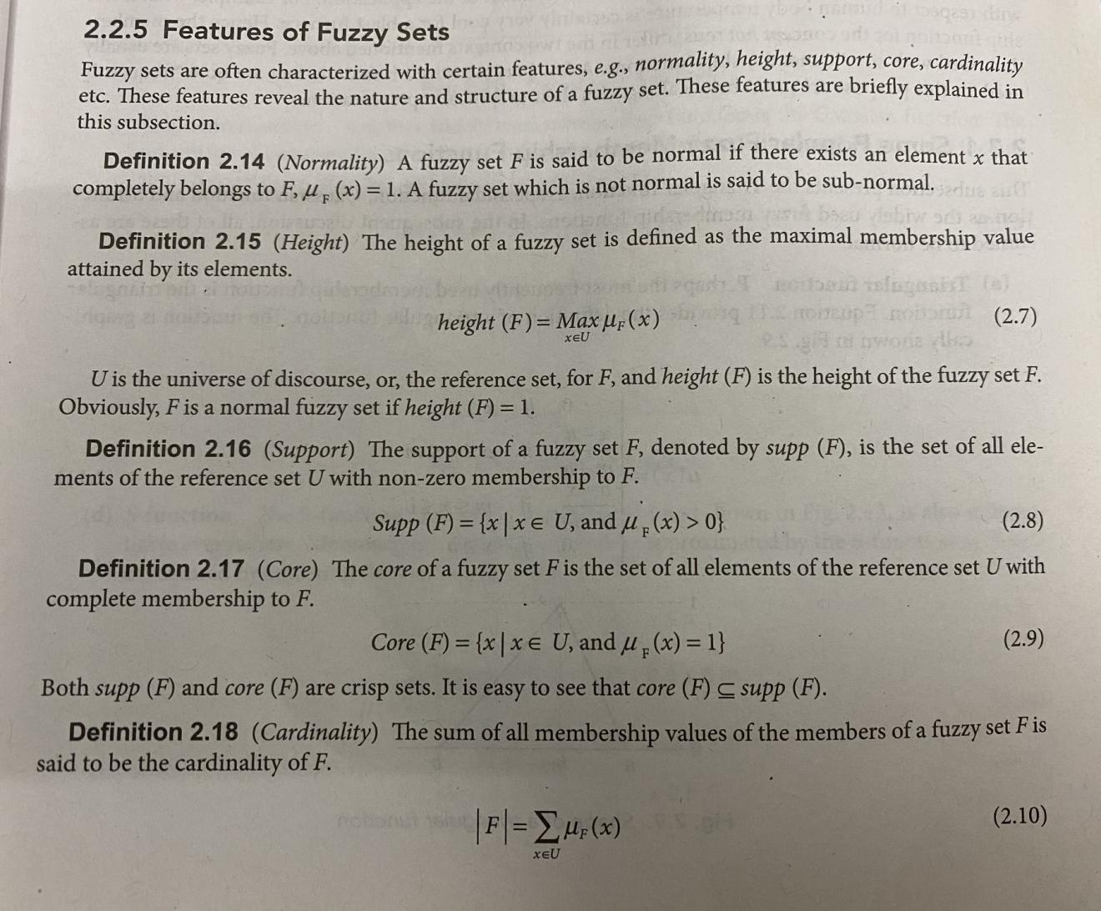

Slide 29
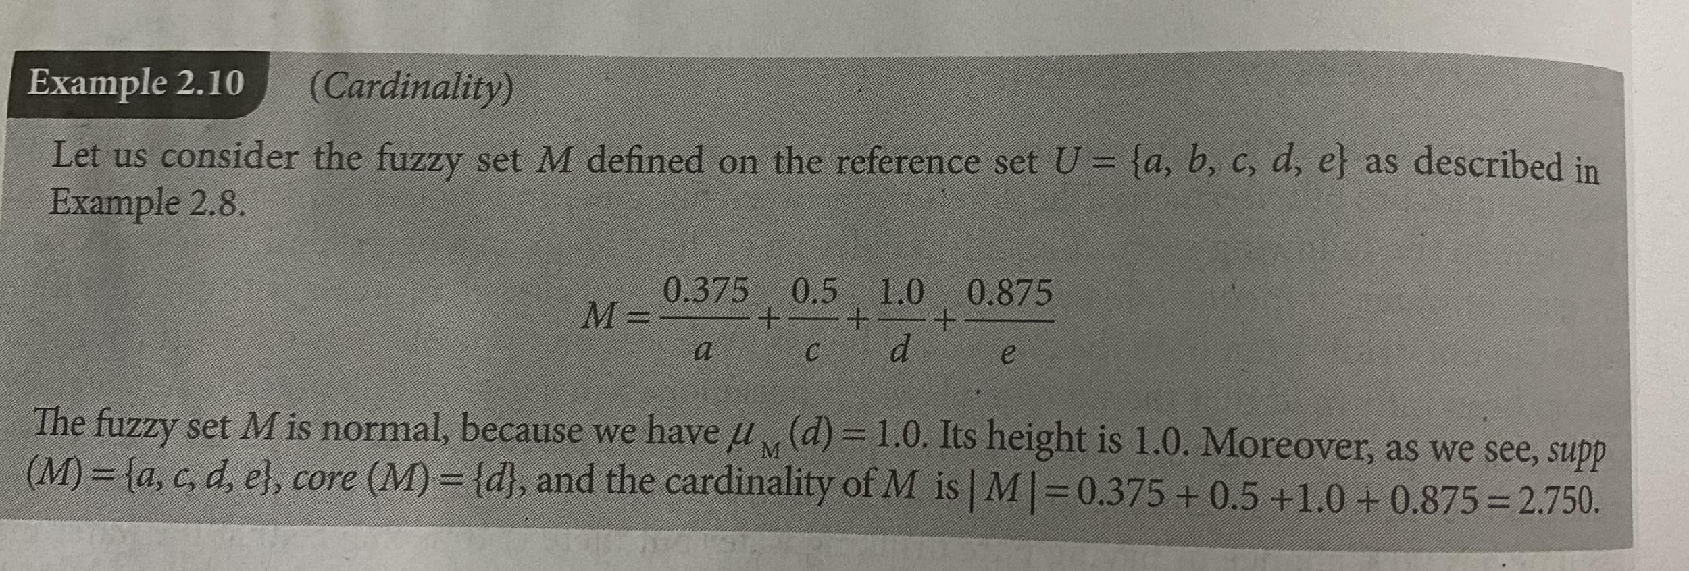
Ex on features of fuzzy set

Slide 30
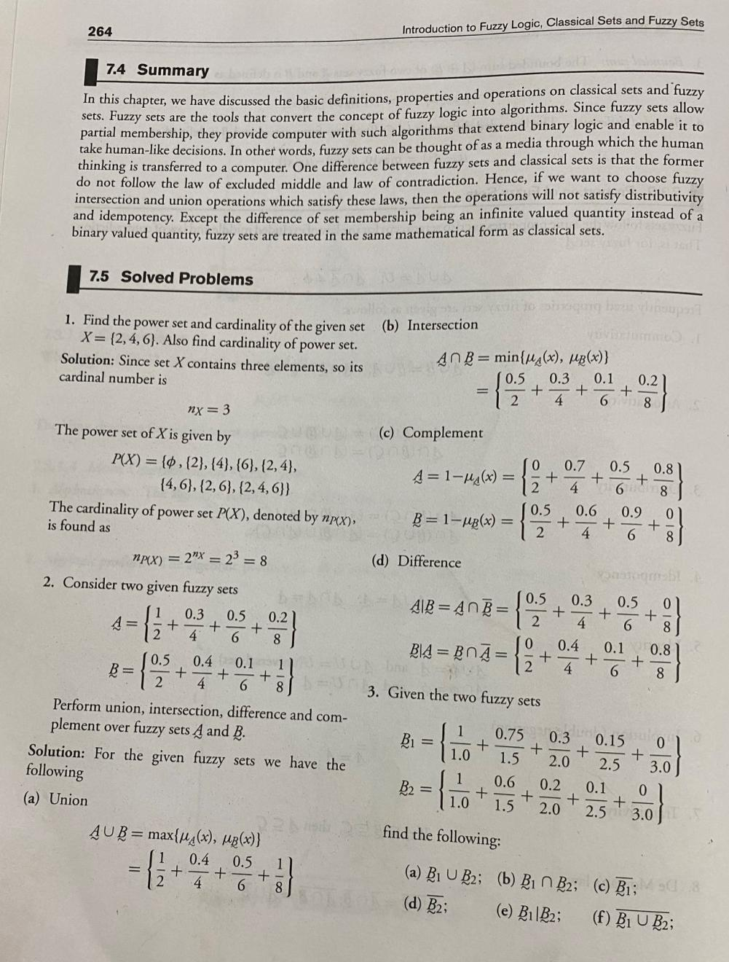

Slide 31
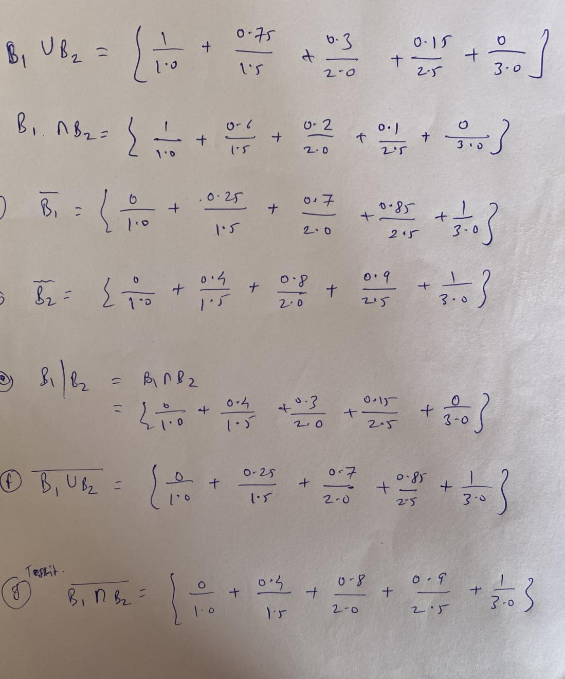

Slide 32
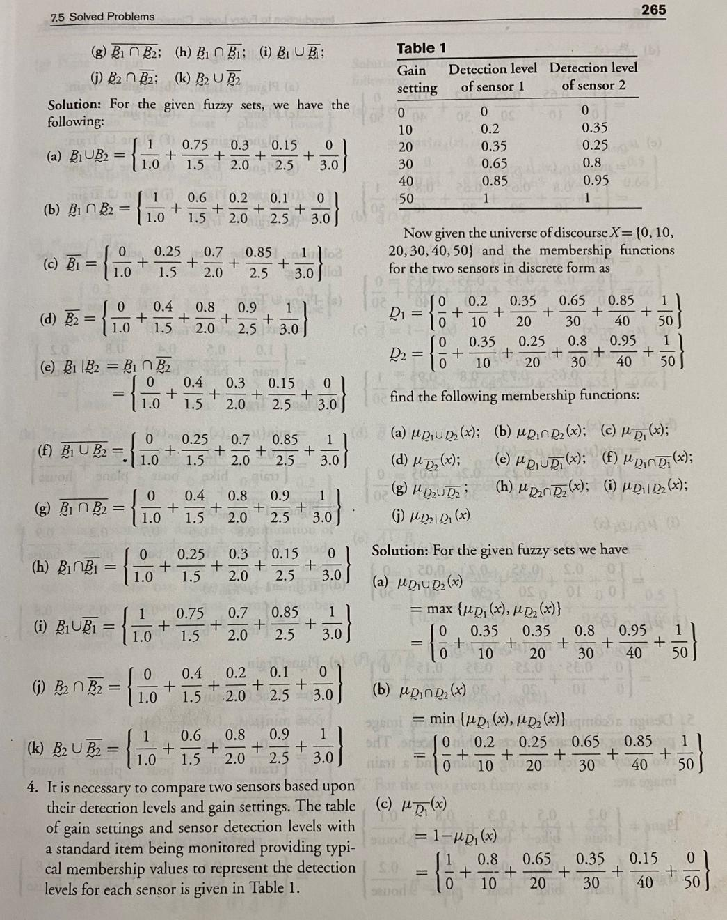

Slide 33
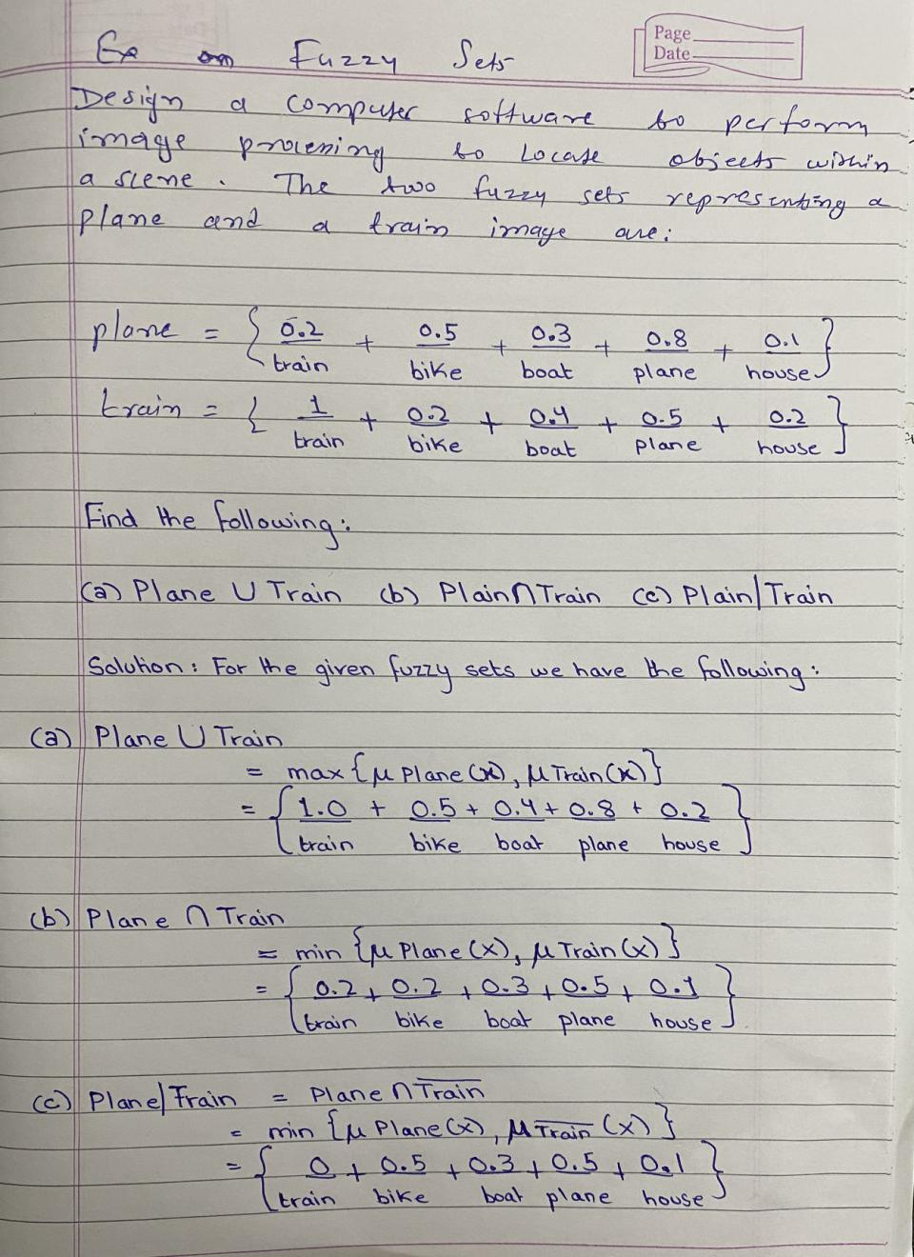

Slide 34
Fuzzy Relations Lecture 6 02/10/2020
Crisp Relation
Cartesian Product,
Crisp Relation,
Relation Matrix T for crisp Relation,
Opearations on Crisp realtion
Union,
Intersection,
Complement and
Composition

Slide 35
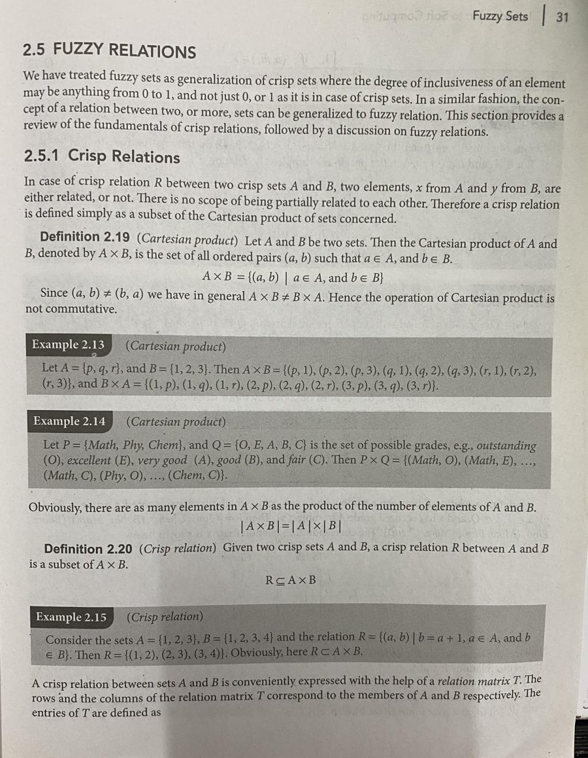

Slide 36
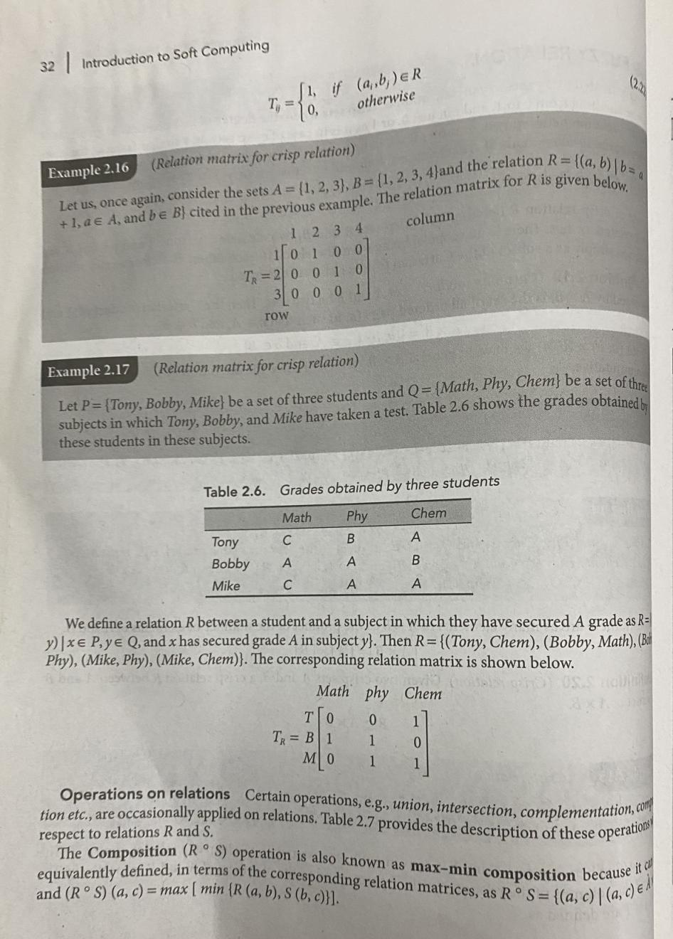

Slide 37
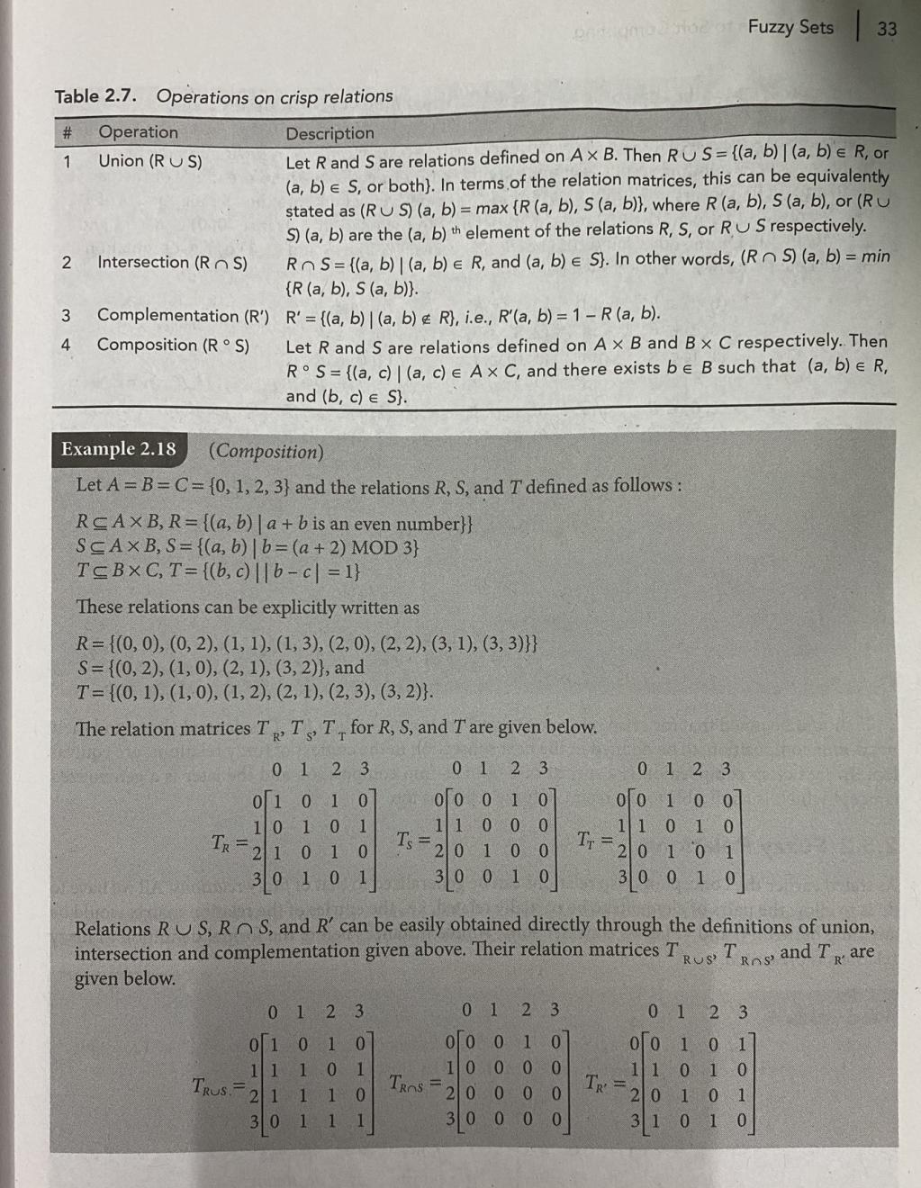
Ex. for Relation R choose (a,b) pair such that (a+b) is an even no.
ex. (1,1) so, 1+1=2= even no, (1,3) so, 1+3 =4= even no.

Slide 38
Recap Fuzzy Relations Fuzzy Cartesian Product and EX Fuzzy relations and EX Operations on Fuzzy relations Max Min Composition of fuzzy relation and Ex

Slide 39
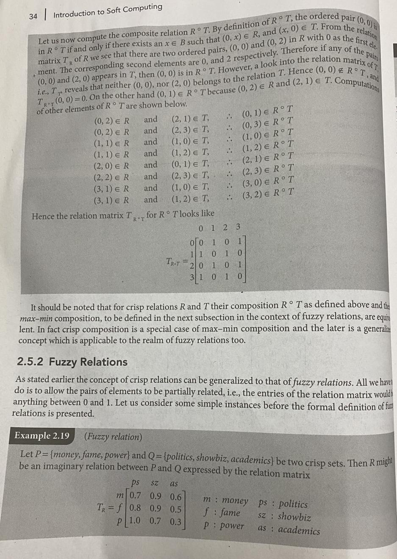
Fuzzy relation... sample imaginary relation

Slide 40
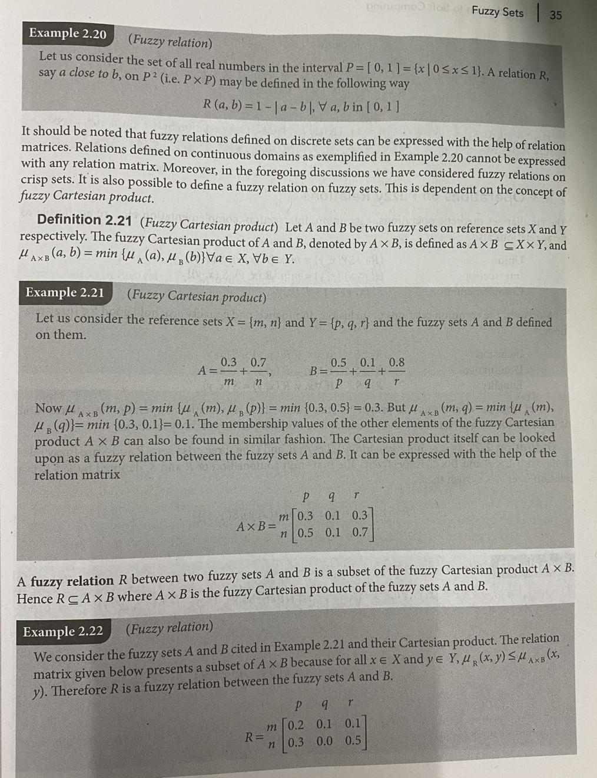

Slide 41
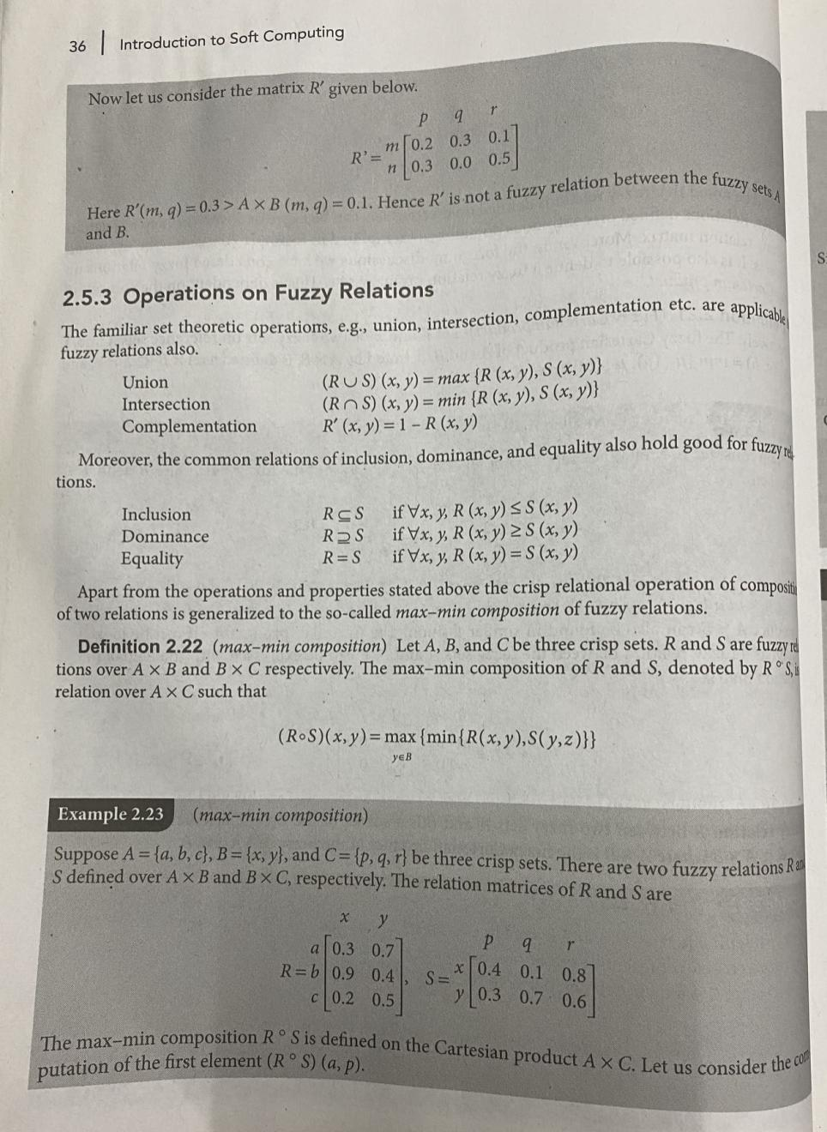

Slide 42
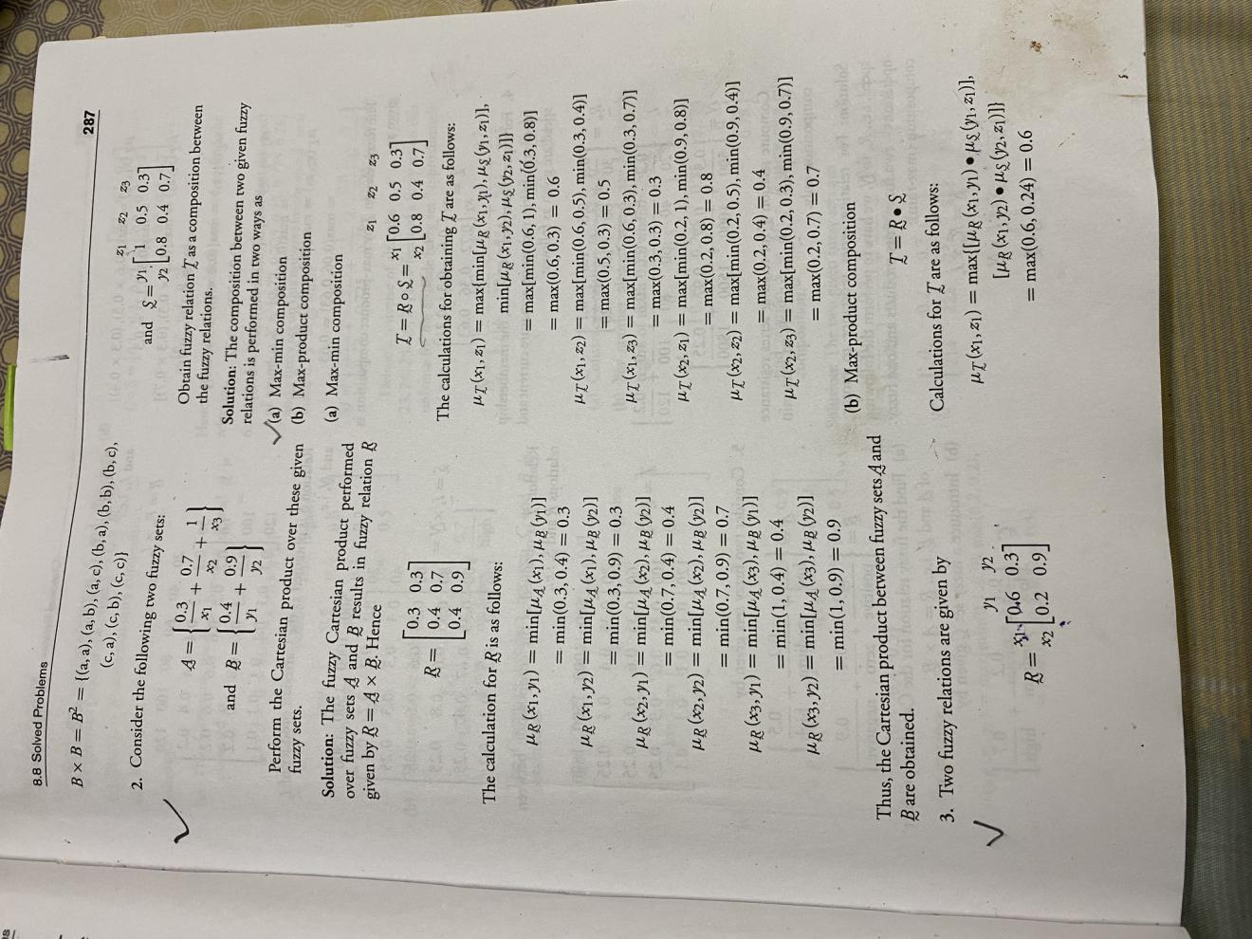
Refer slide 38,....ex 2.21 (Fuzzt Cartesian Product) Q.Perform the cartesian product over these given fuzzy sets

Slide 43
Max Min Composition
Ex 3

Slide 45
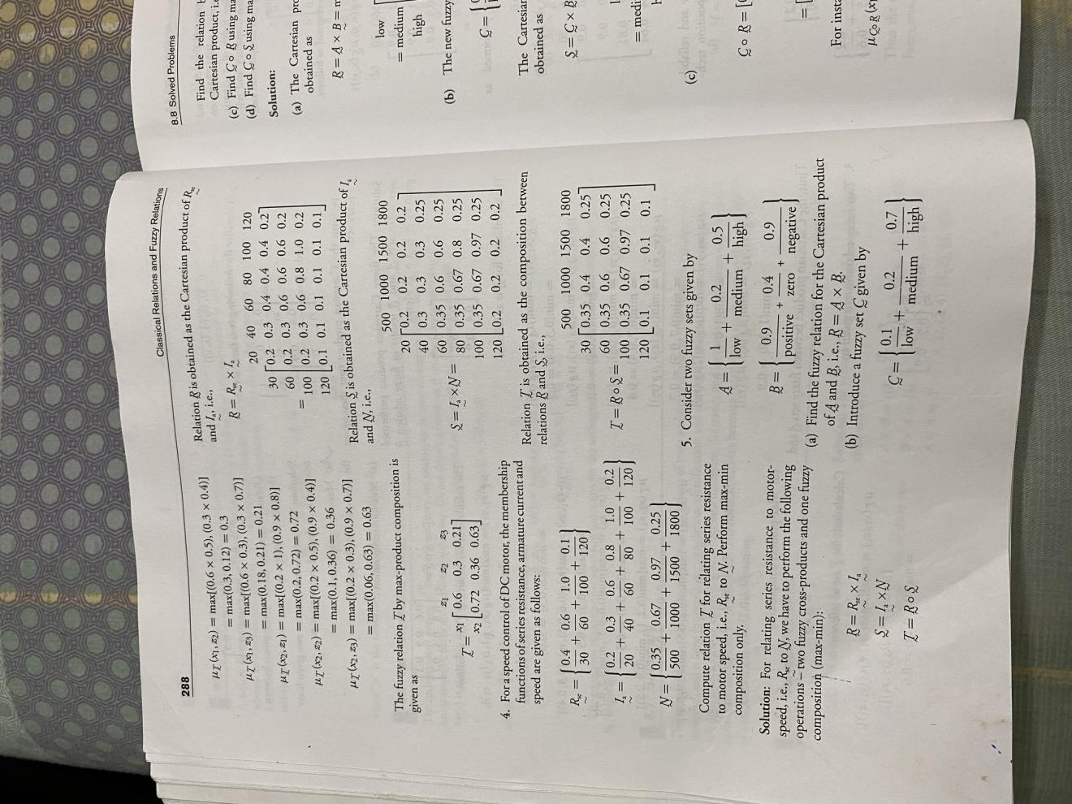

Slide 46
Membership function Features of membership function
Lecture 7

Slide 47
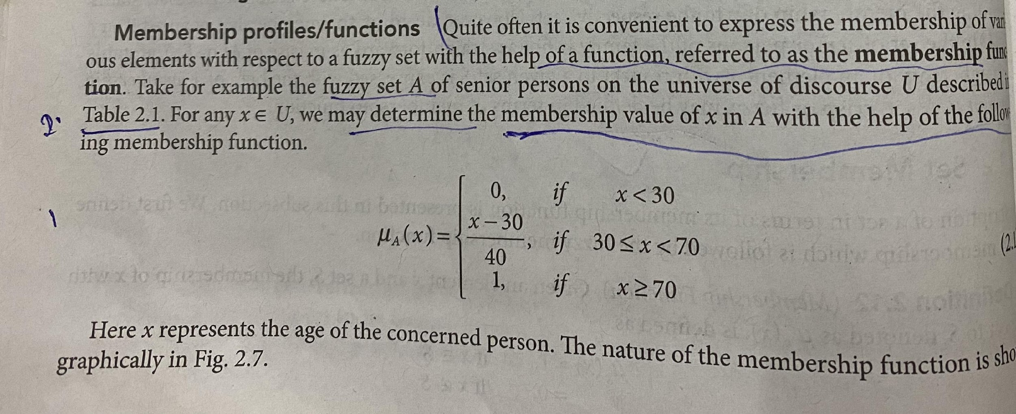
Compute the membership values for each Family members using above membership function?

Slide 48
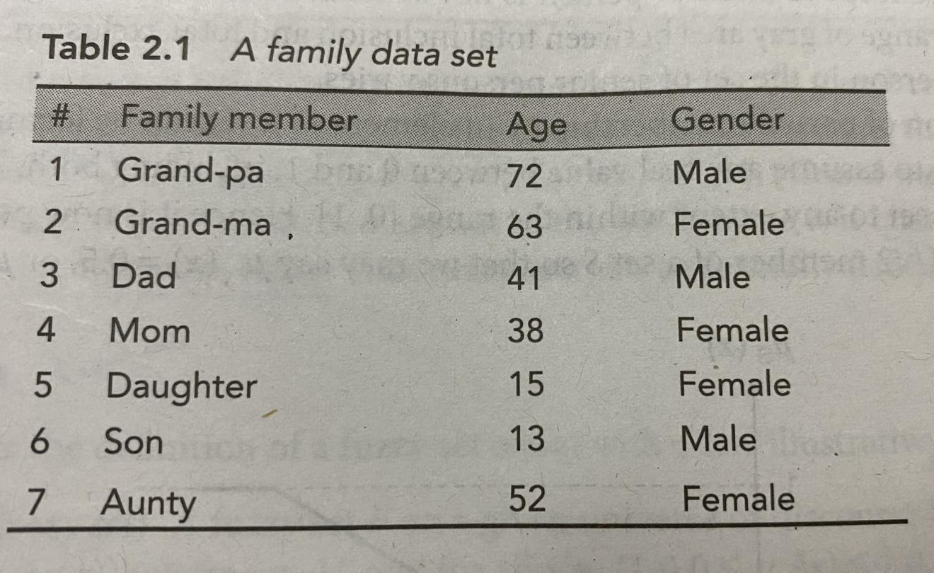

Slide 49
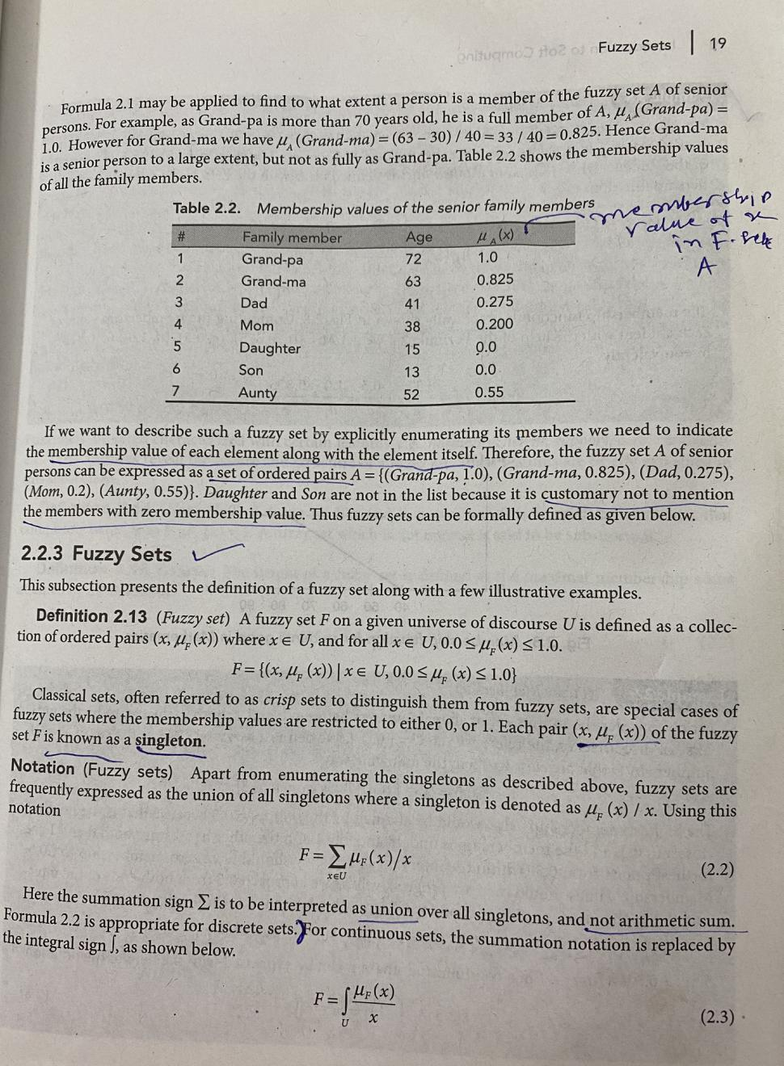

Slide 50
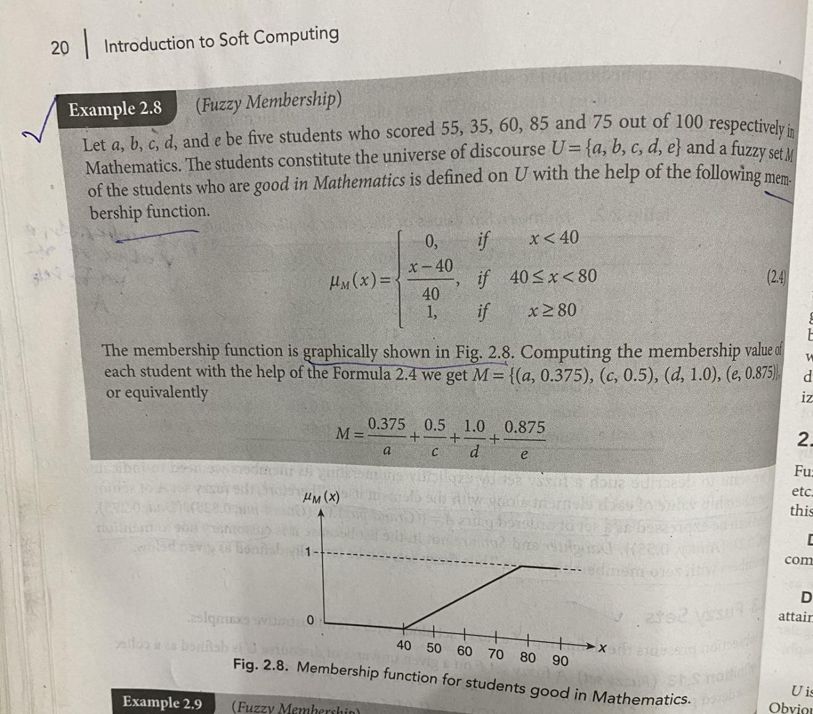
Example How to compute membership values and show graphically membership function ?

Slide 51
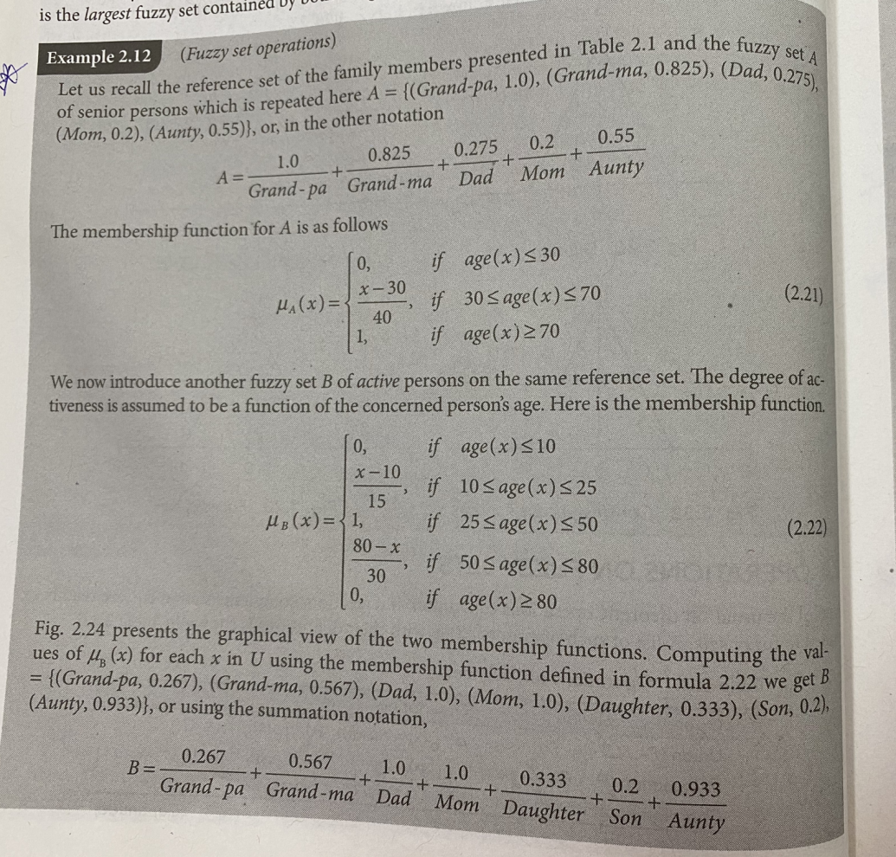
Set A and Set B
ex.Daughter with age 15 , computing the membership values using above membership function
15- 10/15 = 5/15 =0.333
Grand-pa with age 72 , computing the membership values using above membership function
80-72/30=8/30=0.266667=0.267

Slide 52
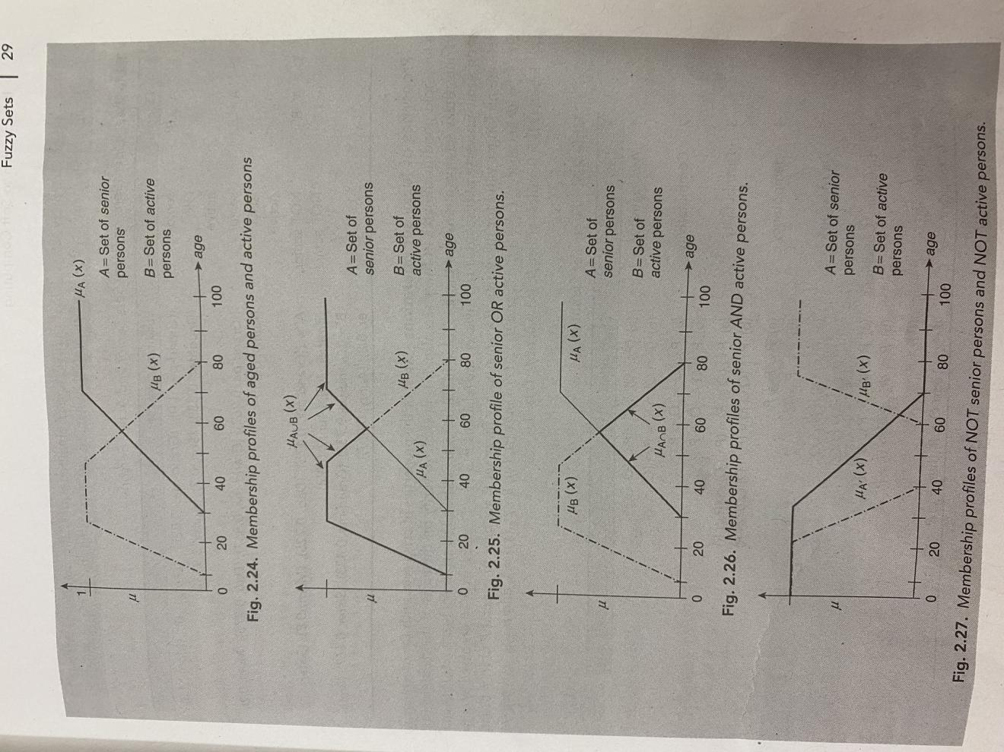
Membership Profile of A= Set of senior persons B= Set of active persons

Slide 53
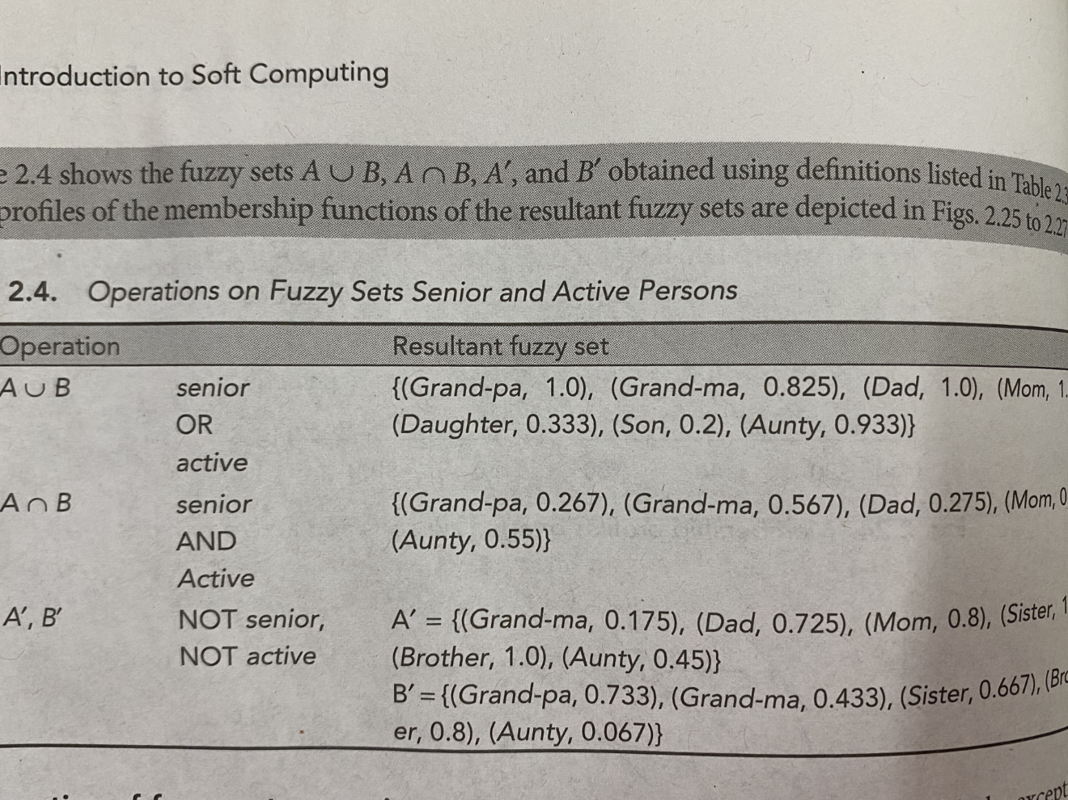
Fuzzy set operations on fuzzy sets A and B

Slide 54
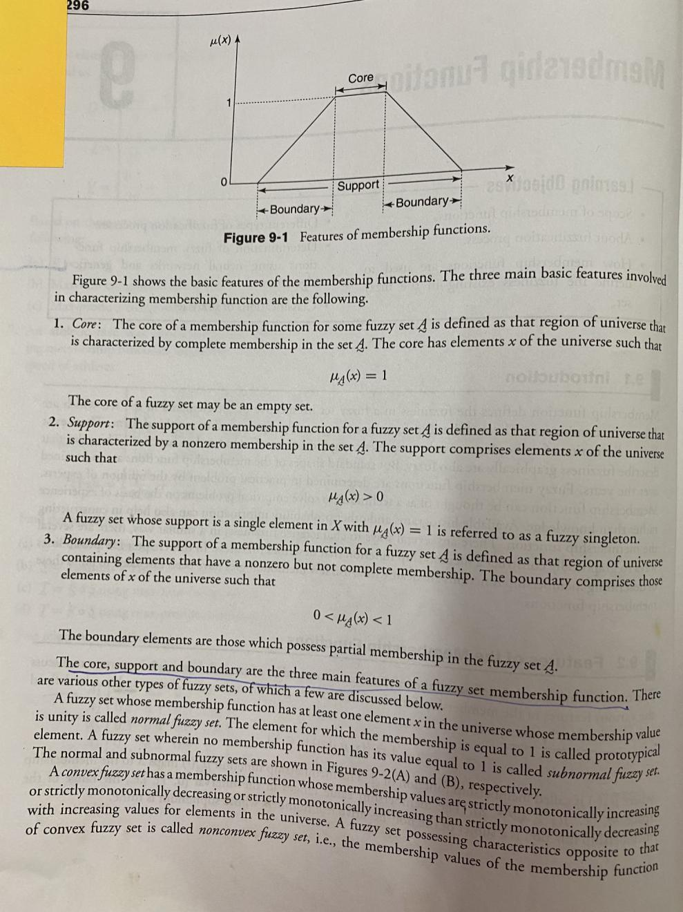
Features of Membership Functions: Core , Support and Boundary

Slide 55
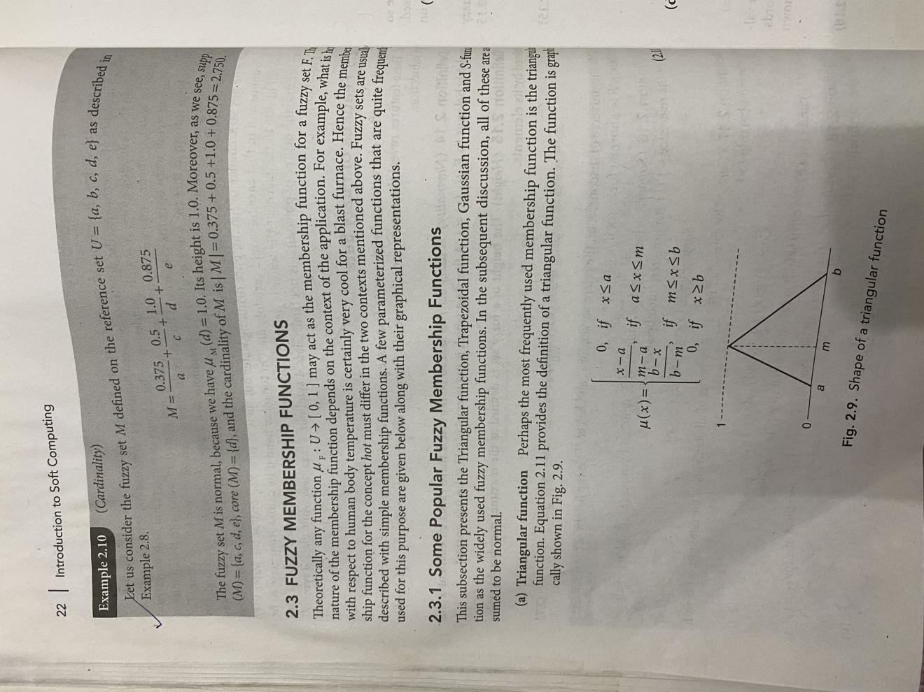
Some Popular Membership function

Slide 56
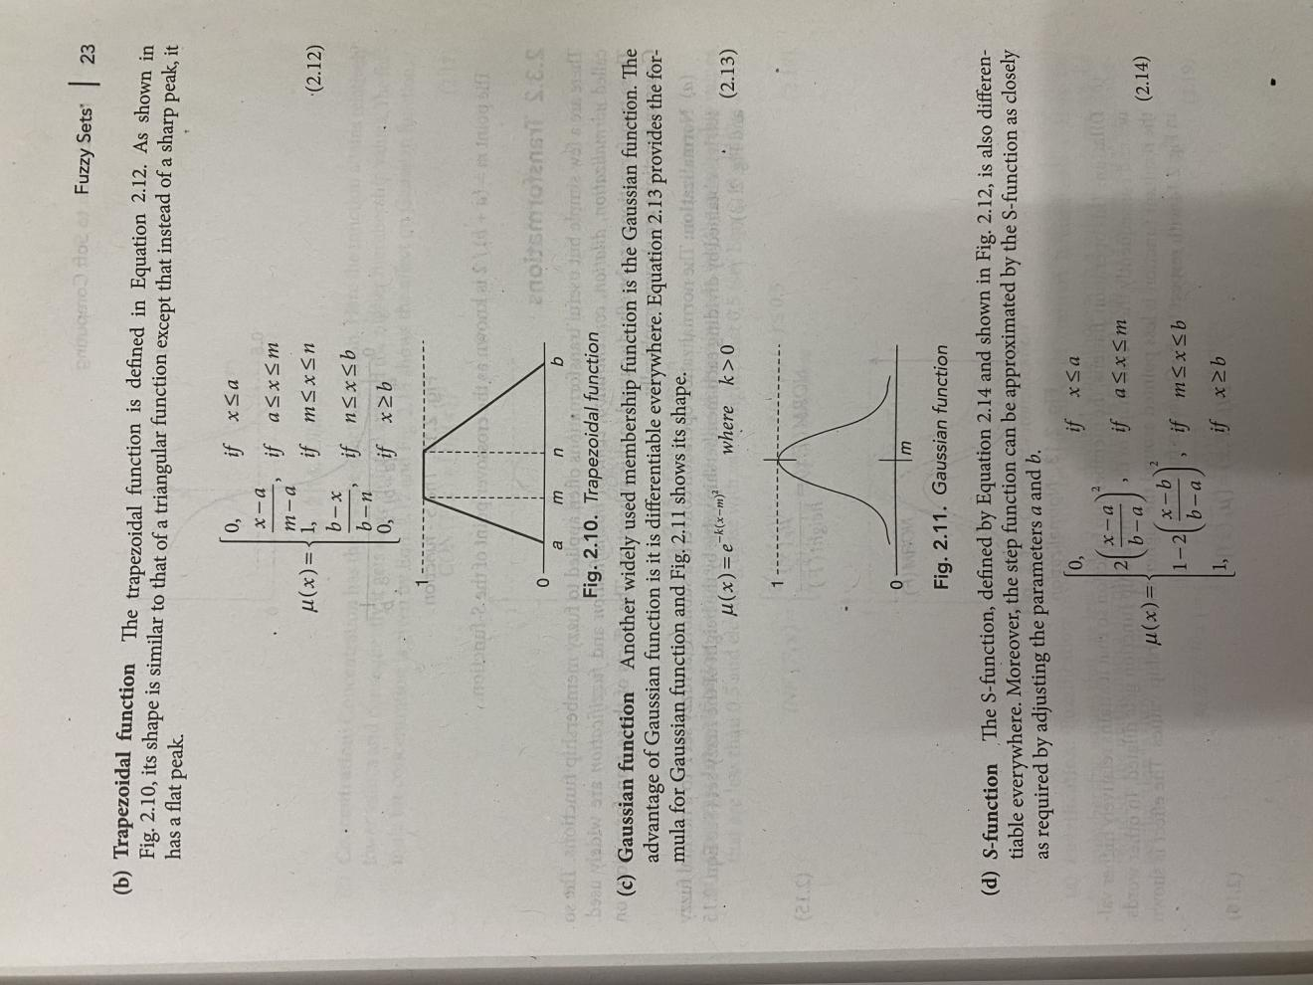

Slide 57
